Slide 1
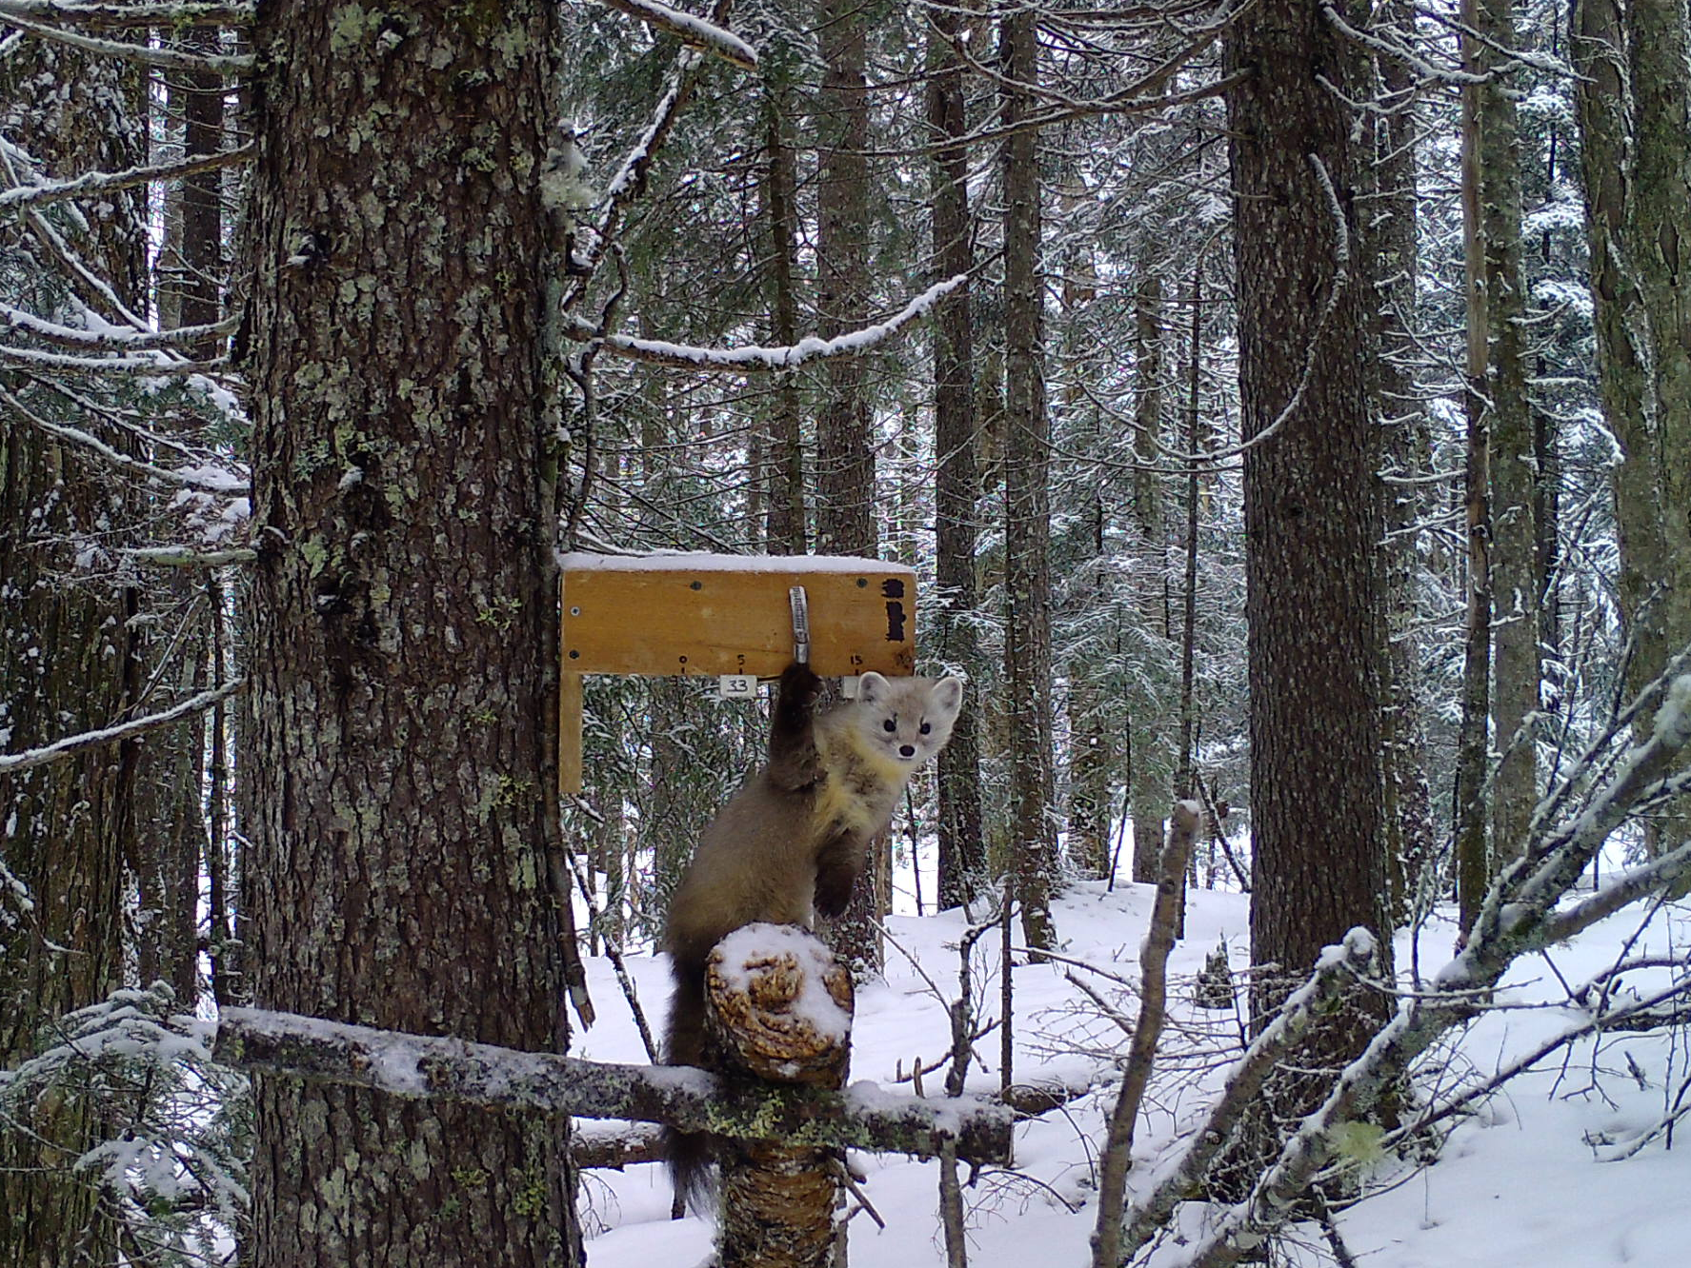


Estimating Marten Density in New Hampshire
Donovan Drummey, University of Massachusetts Amherst
Chris Sutherland, University of Massachusetts Amherst
Jill Kilborn, New Hampshire Fish and Game Department
Notes:
Good afternoon everyone. My name is Donovan Drummey, I am working on my Masters degree down at UMass Amherst.

Slide 2
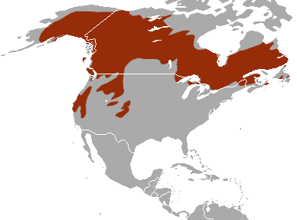
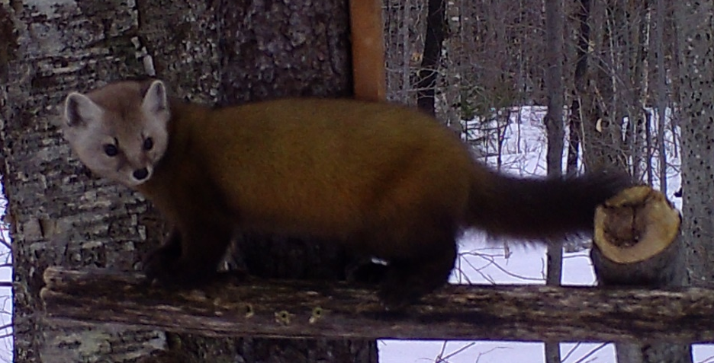
Background
IUCN Red List
Notes:
The American marten is a member of the Mustelid family. Their range is extensive, stretching coast to coast across northern North America, further south along the major mountain ranges, and into the northeastern US. They are considered a boreal species with specific habitat requirements including complex forest structure and deep winter snow.

Slide 3
Background
HISTORIC RANGE
CURRENT RANGE
IUCN Red List
From Kelly 2005
Notes:
If we zoom in for a closer look locally, we can see marten were once found across most of the northeast, as in the top image. Near the beginning of the 1900s, marten range had severely contracted, the lower image. This was due to a combination of habitat loss and overharvesting for their furs.

Slide 4
Background
HISTORIC RANGE
CURRENT RANGE
IUCN Red List
From Kelly 2005
Notes:
In New Hampshire, the extremely low population numbers precipitated a moratorium on trapping and multiple reintroduction attempts, but none of these actions seemed to have much effect at the time. Marten remained scarce throughout much of the state.
As a result, marten became one of the first species listed under the state endangered species conservation act in 1979. Since then, continued protection and habitat improvement have led to some level of recovery and increased sightings, especially since 2000. The state has also been able to confirm that reproduction is occurring in the marten populations, so in 2017 they were removed from the state list.

Slide 5
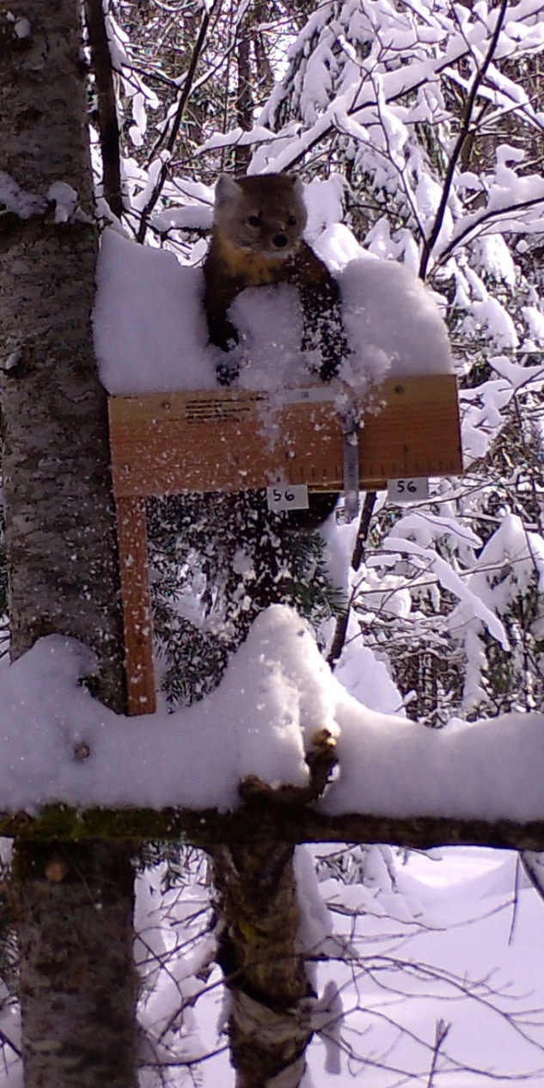
Why study marten in New Hampshire?
Need a clearer picture!
  Presence
  Distribution
  Population size
Need to keep monitoring!
  Establish baseline
  Refine methods
  Define habitat
Notes:
So, if they are doing better, what more do we need to know? Though there was enough marten activity to warrant the de-listing, Fish and Game does not have a clear picture of their status beyond high is some areas, and low in others. They need to know how widespread marten are across the state, which specific areas have resident martens, and how many marten are in these areas.
Additionally, the state needs a way to monitor the populations, as well as baseline numbers of the current status that they can compare to as the species continues to recover. My work will provide those baseline numbers, flesh out effective methods for monitoring the species, and determine specific habitat associations in the state.

Slide 6
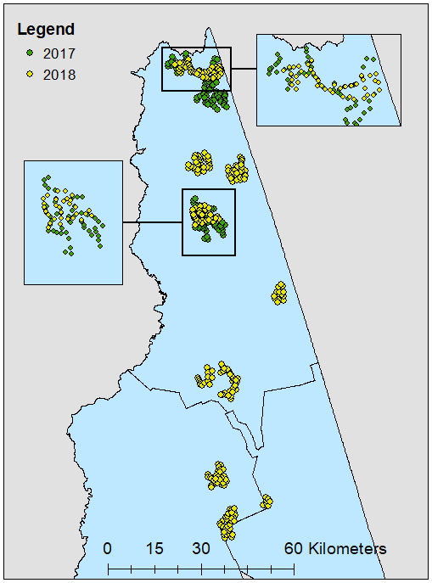
Study Area
2017
150 cameras
1560 trap-nights
Baited when set and after 5 days
2018
261 cameras
2709 trap-nights
Baited only when set
Notes:
With all that in mind, we used baited camera traps to monitor marten in the northern counties of New Hampshire. The trapping season was from early February through the end of April in 2017 and 2018. In this maps, each dot is a camera; the green dots are the 2017 sites, and the yellow are the 2018 sites.
As you can see, we covered a much greater area in the second season. This was due in part to a change in our methods. In 2017, cameras were set for 10 days, but were re-baited after 5 days. We found that re-baiting at this midpoint did not increase the total number of individuals observed, so we eliminated it in 2018 and left the cameras up undisturbed for the full 10 days. This gave us the man-hours necessary to survey more sites.

Slide 7
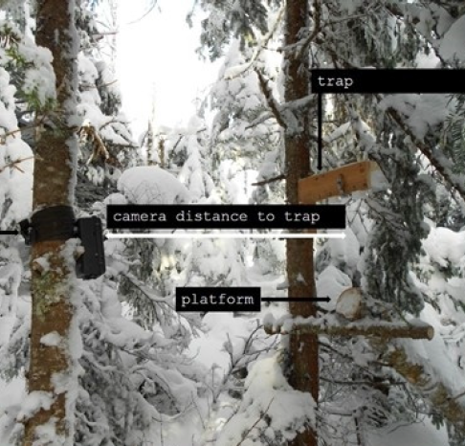
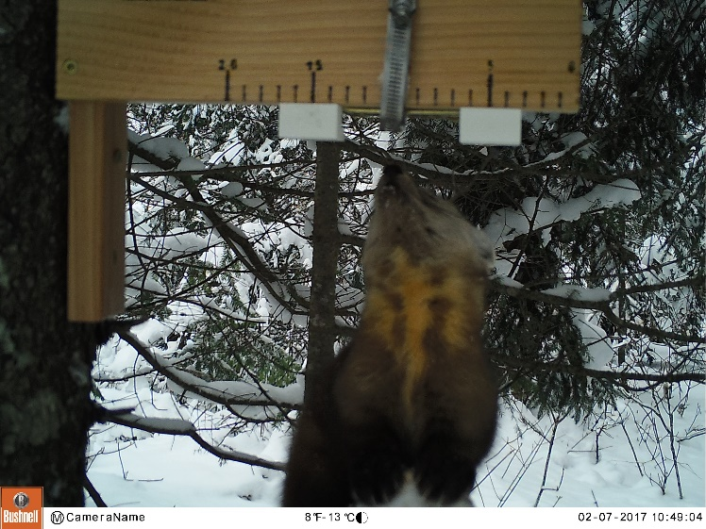

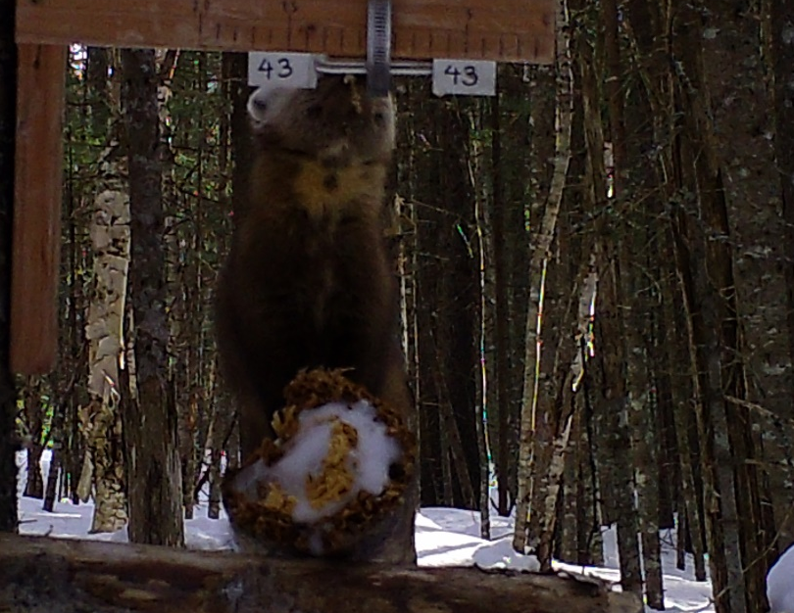

Camera Trap Design
Photo by Alexej Sirén
Sirén, A., P. J. Pekins, P. L. Abdu, and M. J. Ducey. 2016. Identification and density estimation of American martens (Martes americana) using a novel camera-trap method. Diversity 8.
Notes:
The trap design was developed by Siren et al. The camera is on the left, and on the right is a ramp leading up to a platform, with a board with bait attached to it above. This forces the marten to sit back on its haunches and stretch up, giving us clear images of the unique markings on the neck and chest. The markings are natural Rorshach (roar-shack) tests, so we assign them easy to remember names based on what the markings remind us of. These two were named Monster, for the energy drink, and Sauron, for the magic tower from Lord of the Rings.
This ability to name individuals means we can identify when marten are recaptured, either at the same cameras, or importantly, different ones. This is vital, because it turns camera traps - a tool often used to determine presence or abundance - into a tool for determining population densities instead.

Slide 8
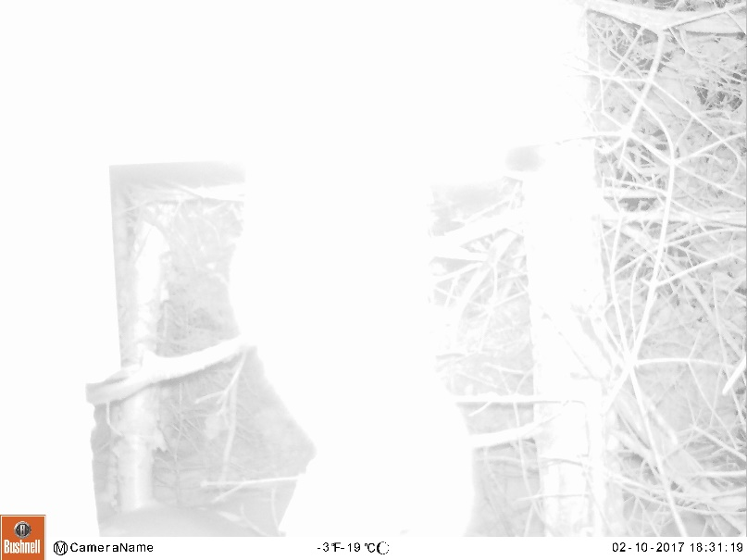
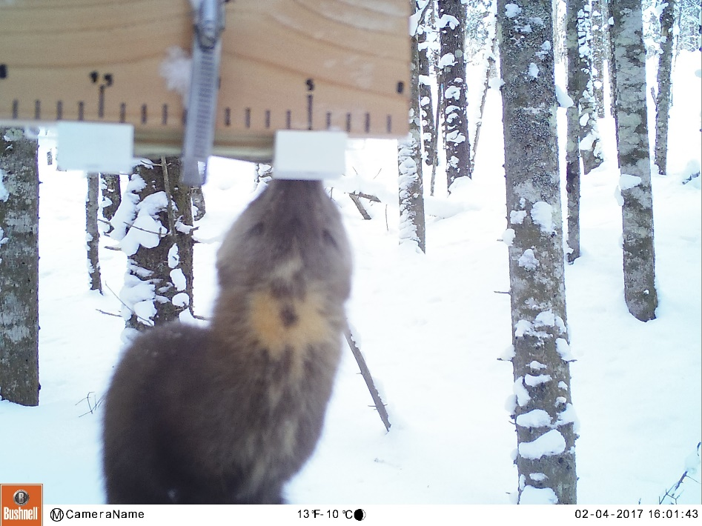
Winter Surveys Summary
CPW Photo Warehouse
  Species ID
  Visit delineation
  Individual ID
Notes:
I processed the images using the program CPW Photo Warehouse before exporting the data for analysis; I would be happy to answer any questions about the program after my presentation. With this program, I identified all images to species, divided them into unique ‘visits’ –series of images showing an animal’s interaction with the trap – and then assigned all marten visits to an individual. I was able to positively identify – assign a visit to an individual, rather than ‘unknown’ – to ~80% of the individuals in 2017, and ~60% of those in 2018. This large difference in success rates is interesting, especially since we successfully tweaked our camera setup slightly in 2018 to reduce difficulties caused by flash whiteout and blurriness. However, some interesting trends in the data may help explain this discrepancy.

Slide 9
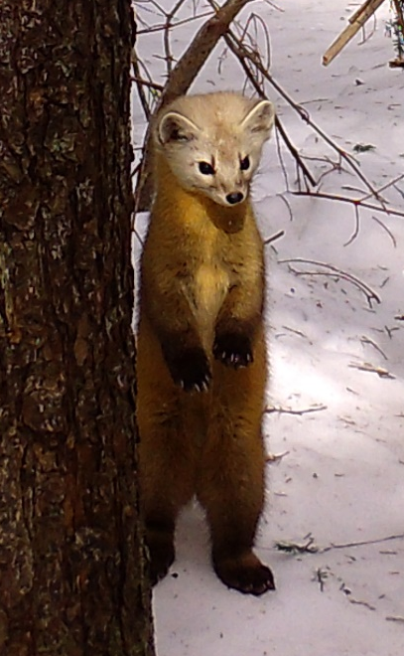
Winter Surveys Summary
2017 2018
Effort <
Images >
Species <
Images >
Visits <
Individuals <
Overall
Marten
Jensen, P. G., C. L. Demers, S. A. McNulty, W. J. Jakubas, and M. M. Humphries. 2012. Marten and fisher responses to fluctuations in prey populations and mast crops in the northern hardwood forest. Journal of Wildlife Management.
Notes:
I mentioned earlier that our trapping effort was greater in 2018. Despite the increased effort, we collected slightly more images in the first year. This pattern seems contradictory to the fact that we saw almost twice as many species in the second year, but actually makes a lot of sense. In 2018, we covered a much greater area, and thus also surveyed in a greater variety of habitats.

Slide 10
Winter Surveys Summary
2017 2018
Effort <
Images >
Species <
Images >
Visits <
Individuals <
Overall
Marten
Jensen, P. G., C. L. Demers, S. A. McNulty, W. J. Jakubas, and M. M. Humphries. 2012. Marten and fisher responses to fluctuations in prey populations and mast crops in the northern hardwood forest. Journal of Wildlife Management.
Notes:
An even more interesting pattern emerges within the marten images. We had far fewer total marten images in 2018 – less than a quarter of 2017 – but had more visits in 2018, and twice as many individuals. More individuals in 2018 makes sense for the same reason more species did; we surveyed a greater area, and thus surveyed more individual home ranges
The larger number of visits paired with the lower number of total images suggests that visits were shorter in duration in 2018. In 2017, marten spent an average of 14 minutes at the camera. In 2018, this decreased to only 6. This change in visit duration is what explains the lower individual identification rates in 2018. Quite simply, the longer a marten spends at a trap, the more likely we will get an image that can be used to positively identify the individual. I don’t have a definitive answer for why visits got shorter, but I do have a possible explanation.

Slide 11
Winter Surveys Summary
2017 2018
Effort <
Images >
Species <
Images >
Visits <
Individuals <
Overall
Marten
Jensen, P. G., C. L. Demers, S. A. McNulty, W. J. Jakubas, and M. M. Humphries. 2012. Marten and fisher responses to fluctuations in prey populations and mast crops in the northern hardwood forest. Journal of Wildlife Management.
Notes:
In 2012, Jensen et al. published a paper describing patterns in marten and fisher trapping in New York. They found that capture rates for both species declined following a mast year. They attribute this to the greater availability of food sources, both from the mast as an immediate food source in the fall, and increased small mammal prey availability during the following winter.
In my case, the summer of 2017 saw large amounts of both hard and soft mast in New Hampshire, especially of cone species and mountain ash. Increased prey availability in early 2018 likely made the baited camera traps less enticing than they were in 2017.

Slide 12
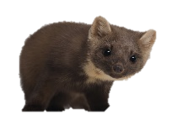
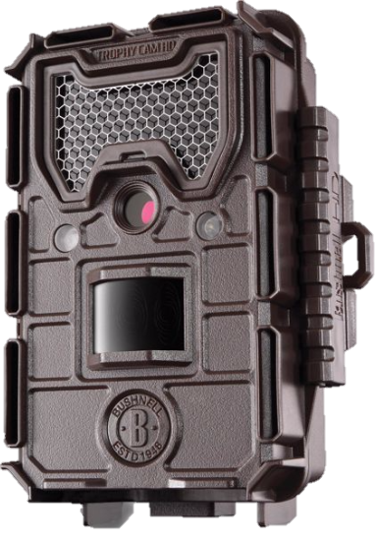
SCR: A step beyond Mark-Recapture
Capture Histories
MR
Occasion
1 2 3 4 5
A 1 1 1 1 1
A
Greg
B
C
Occasion
1 2 3 4 5
A 1 0 0 0 1
B 0 1 0 0 0
C 0 0 1 0 0
D 0 0 0 0 0
E 0 0 0 1 0
SCR
D
Greg
E
Notes:
I analyzed the camera data using spatial capture-recapture, or SCR. Like more traditional mark-recapture methodologies, SCR depends on being able to capture, then recapture some portion of the population, creating a capture history of individuals. Capture histories are a binary description of when an individual was observed. So if this marten – let’s call him Greg - was observed over the course of five days to travel from site A, to B, to C, to E, and back to A, the capture history for Greg with mark-recapture would be a series of ones; it doesn’t matter which site Greg was observed at, just that he was observed during that day.
SCR breaks the capture history down by site as well as each occasion. The inclusion of this spatial data makes it possible to infer movement and space use of the marten we capture.

Slide 13
SCR: A step beyond Mark-Recapture
MR
A
B
C
SCR
D
E
Notes:
The reason we can’t make these inferences with MR is because the area that is effectively being sampled is ambiguous. Animals can move to your camera traps, so they each effectively survey an area around them. The problem is determining how big that area is! We can make guesses, and often draw arbitrary boundaries around our sites, but with MR they are just guesses. Thus, your estimates are exposed to potential error, depending on if your guess was too large or too small.
SCR takes away that ambiguity by allowing our marten recaptures to inform the size of the effective area around each camera, instead of for the area as a whole. But how do we do that?

Slide 14
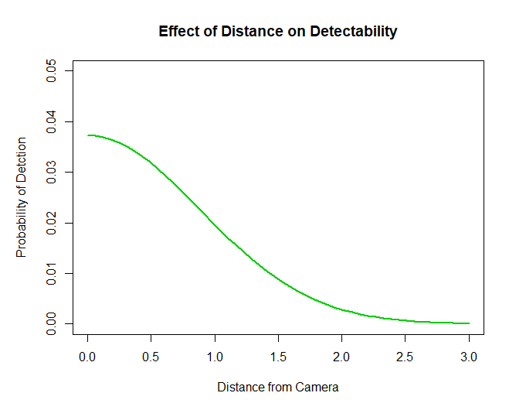
SCR: A step beyond Mark-Recapture
A
A
B
D
C
D
E
Notes:
Essentially, we know that our ability to detect an animal decreases the further its activity center is from our camera. We also know that, in Greg’s case, camera A is likely closer to his activity center, since he visited it more often than the other sites, and D is the furthest, since he never visited it. We can use this to calculate a probability curve denoting how detection declines with distance. In this example, site A would fall somewhere along the top of the curve, while D would fall somewhere near the tail.
This is just the basics behind SCR models; I’m happy to answer questions later, but I want to move on and discuss the preliminary models I have run. SCR models include variables that affect marten density on the landscape, their use of space, and our ability to detect those individuals, I intend to test a suite of candidate models, but am not there quite yet. At this point, I am just exploring!

Slide 15
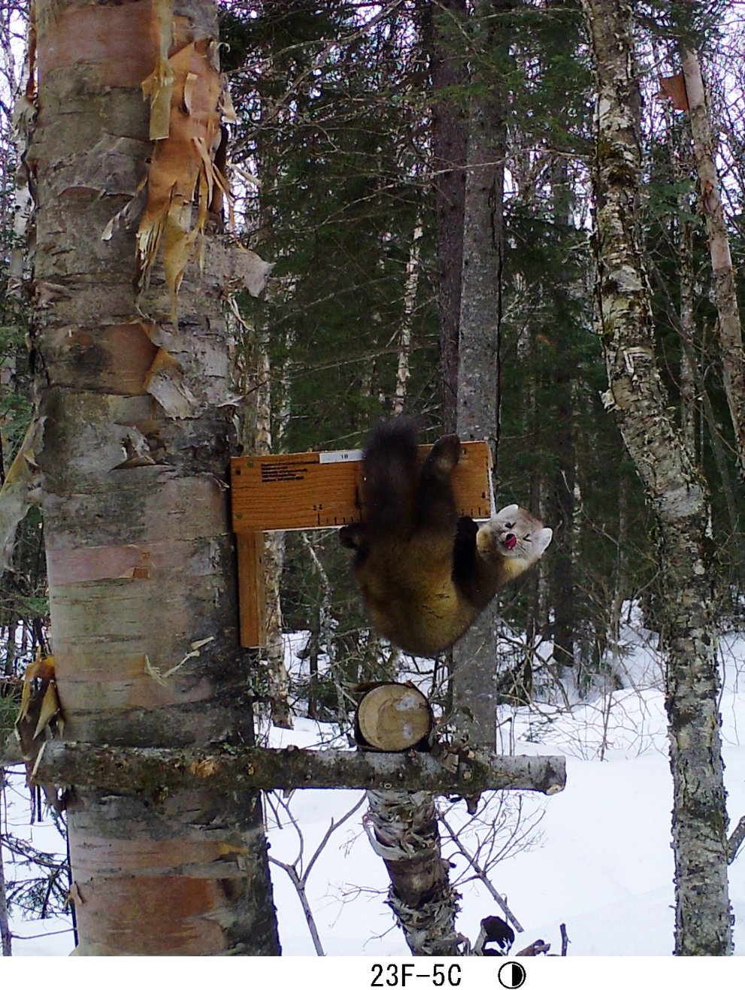
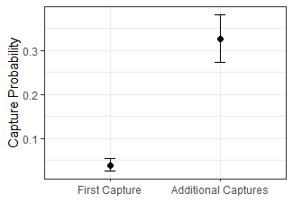
Detection Variables
Notes:
For detection, I am considering only a single variable here related to marten behavior. Marten are known to be quite trap-happy. If they find a tasty treat – like a box of sardines – at a trap, they will likely visit the site again.
It is important to account for this behavior because it means that the probability of capturing a marten is not constant over time. Instead, as you can see in this image, the probability of observing a marten is very low for its first capture, but greatly increases after that. Free food is apparently as big a draw for marten as it is for college students!
Since there is a large body of research confirming that marten are trap happy, I used this behavioral model as an informed null in this first set of models.

Slide 16
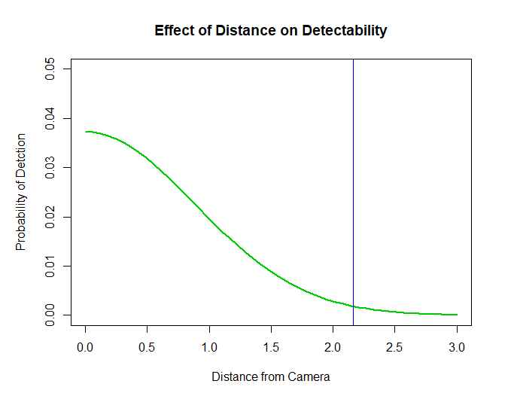
Space Use
2.2km
2.2km
95% home range = 14.5km²
Notes:
The space use parameter, sigma relates back to how detection declines with distance from the activity center. Sigma is the radius of a circle around the camera that is equivalent to a 95% home range size for the marten. In my case, sigma was approximately 2.2km, which means that each camera effectively surveys 14.5km^2.
If we know each camera can sample up to 2.2km away from itself, we could theoretically place them about 4km apart without leaving unsampled gaps between cameras. Of course, I’d recommend keeping them a bit closer than that to ensure the camera ranges overlap, and to alleviate the extremely low detection rates near the edges of the effective sampling area.

Slide 17
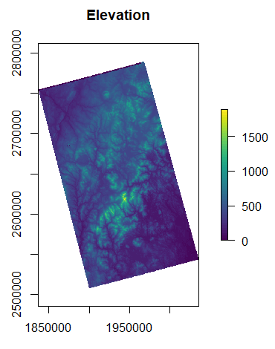
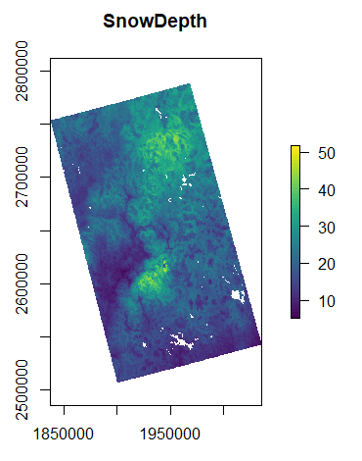
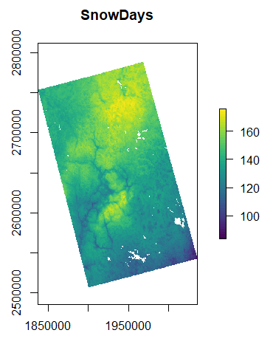
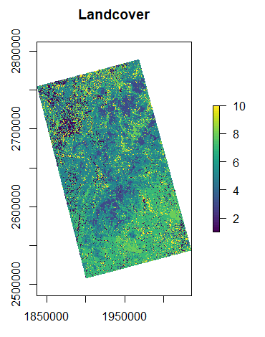
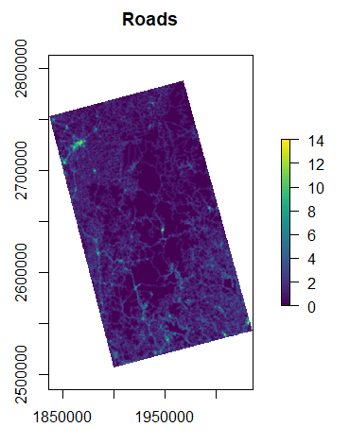
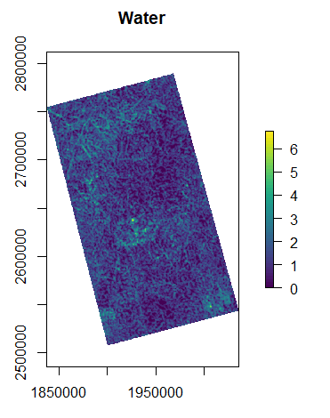
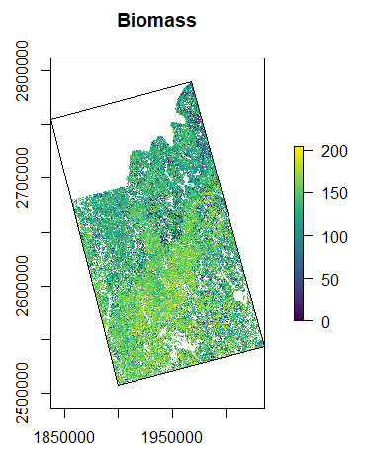
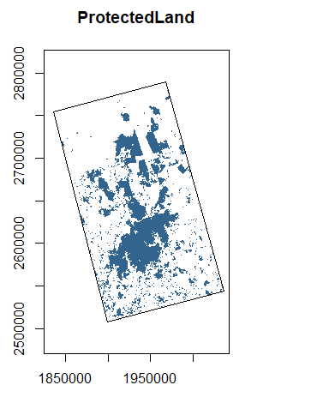
Density Variables
Notes:
Duplicate, in case animations get messed up.

Slide 18
Density Variables
Notes:
Simultaneously, I considered habitat variables that would affect density. I selected most of these density covariates selected based off a literature review I conducted of recent marten research across their range, plus a few suggested by my collaborators.
The variables from the literature review included: Elevation, snow depth - the total snow accumulation during the winter season, roughly October to May, Snowdays - the number of days with snow on the ground over that same period, Landcover, road density, and stream density. My collaborators suggested an additional 2 variables. The first, biomass, measures the aboveground plant matter. The other variable is protection status. This last variable is a binary layer, and includes both public lands like state and federal properties, and private land with conservation easements on it.
For my initial explorations, I tested each of these variables in conjunction with behavior. I ran these models in R, using the oSCR package.

Slide 19
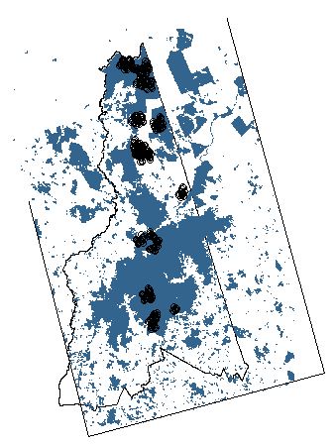
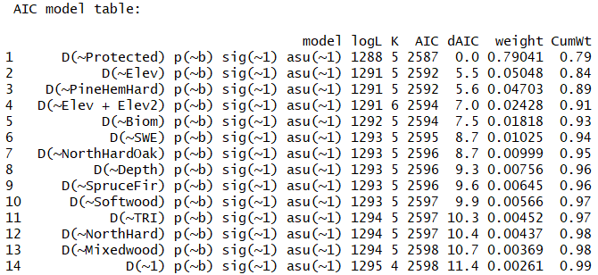
Preliminary Results
Density map
Relationship
Density estimate: 0.2252699
Protected Lands
My density: 0.2 marten/km²
Other studies: 0.5-1.7 marten/km²
Notes:
Of the models tested, protected lands had the greatest support. Density across my study area is 0.2 marten/km^2, which is a bit lower than is reported in other marten research. That is unsurprising here as my study are was large and diverse, and this average included both highly suitable and unsuitable habitats.

Slide 20
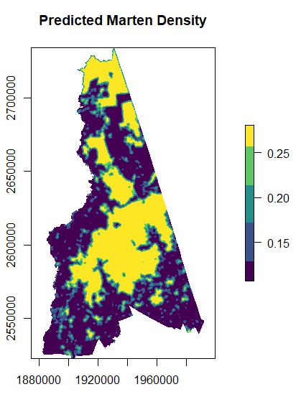
Preliminary Results
Density map
Relationship
Density estimate: 0.2252699
Protected Lands
Notes:
Here, you can see that marten densities are predicted to be highest in the large areas of protected land in yellow, lowest in the dark blue unprotected land, and somewhere in the middle for the small protected and edge areas in green.

Slide 21
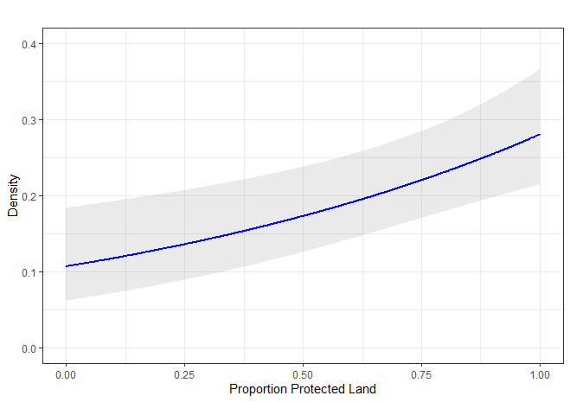
Preliminary Results
Density map
Relationship
Density estimate: 0.2252699
Protected Lands
Effect of Protected Land on Density
Density
Proportion Protected Land
Notes:
We can see that in the unprotected areas, on the left at 0%, marten densities are around 0.1, and in protected areas to the right, densities are near 0.28 marten/km^2.

Slide 22
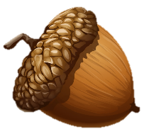
Tying it all together
What have I learned so far?
37,000 marten images
60-80% ID rates
Strong behavioral response (trap happy)
Estimates of space use and HR size
Protected areas are important
Notes:
So, what does all of this mean in the end? Let’s review what we’ve learned:
First, these camera trap methods are effective for capturing marten; marten were the most common species encountered. Moreover, they are highly successful at identifying individuals.
Second, mast may influence marten captures.
Third, marten are trap-happy, and using bait will increase your chances of recaptures.
Fourth, my cameras surveyed 2.2 km from themselves, and could be up to 4km apart from one another and still be effective.
Finally, density across my sites was around 0.2marten/km^2, and protection status seems to have the greatest influence in my data. But remember, these are very preliminary results, as I have only looked at univariate models so far!

Slide 23
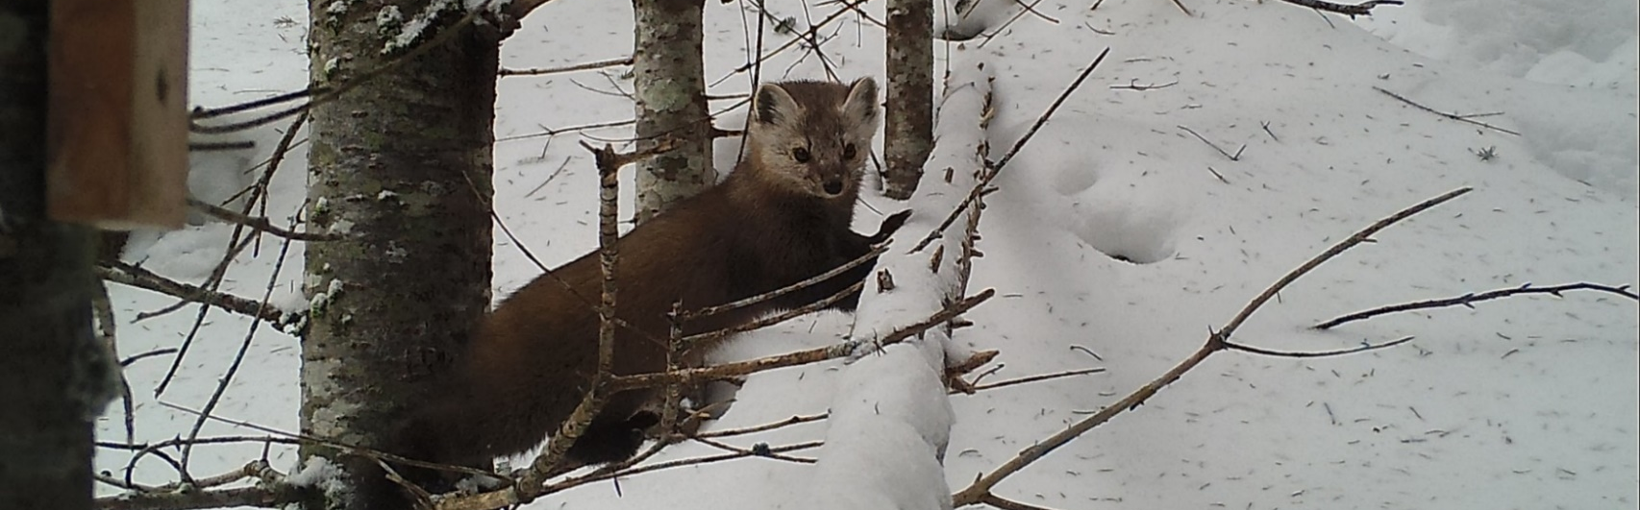
Tying it all together
What’s next?
  Additional variables
  Interactions
  Test all models
  Management implications
Notes:
I’ve still got more work to do! I am gearing up for my final set of models, but first I would like to add two more variables into the mix; fisher occupancy and landscape connectivity. I also want to look at the interactions between some variables, especially landcover and biomass. Once those are all added in, I can run my final models and evaluate the entire NH landscape for potential marten habitat. Finally, I will be able to write recommendations for NH Fish and Game that will inform future monitoring efforts and provide specific management guidelines for improving marten habitat.

Slide 24
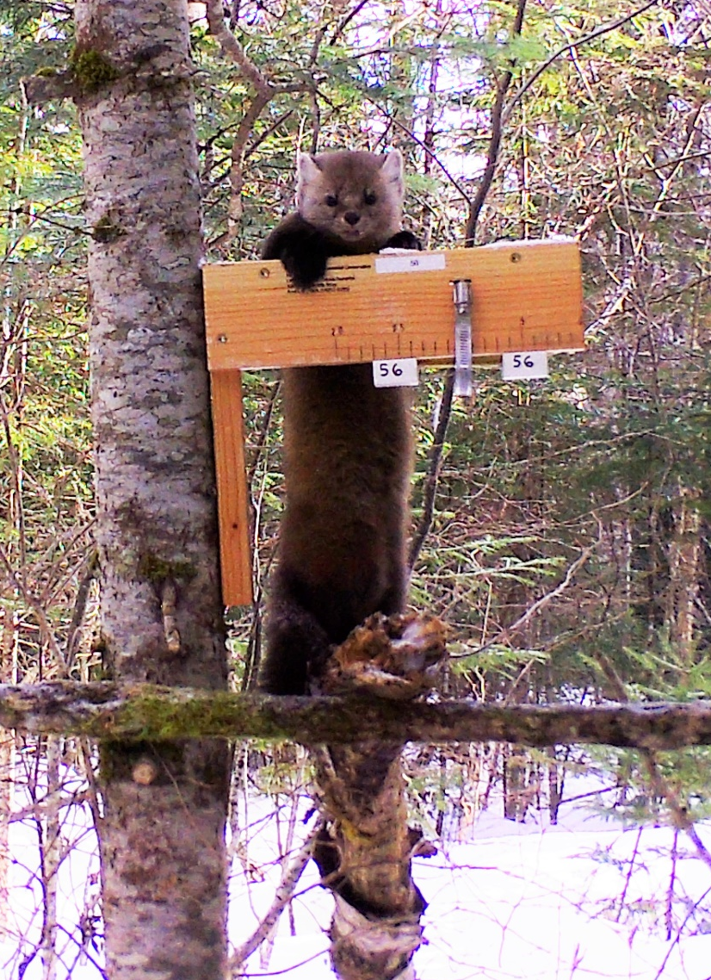
Any Questions?
Thanks to:
NH Department of Fish and Game
Alexej Sirén, Jill Kilborn, and Chris Sutherland
My 20 undergraduate volunteers
Alex Ahlquist, Sam Rode, and Andrew Carrano
Notes:
Before I wrap up, I’d like to thanks to NH Fish and Game, esp. Jill Kilborn for help w/ winter project
People for their advice and expertise for this project
20 undergrad volunteers who helped with photo ID,
My undergrad interns, Alex Ahlquist, Ben Sharaf, Andrew Carrano, and
Any questions?

Slide 25
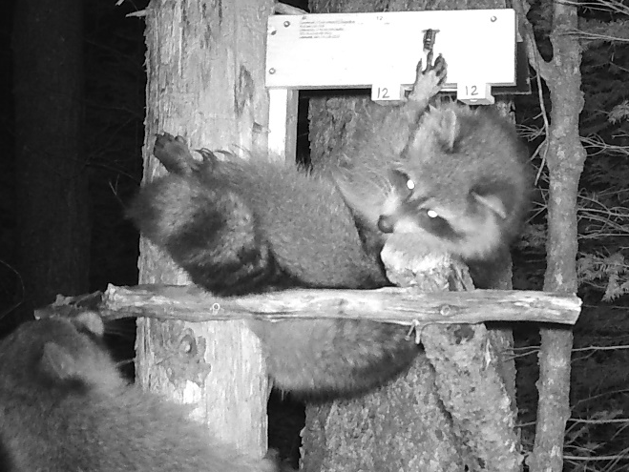
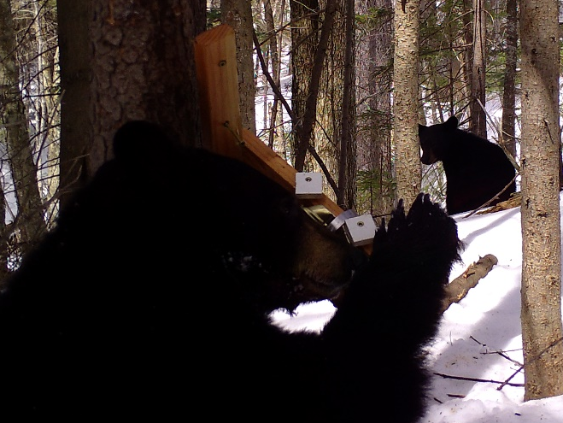
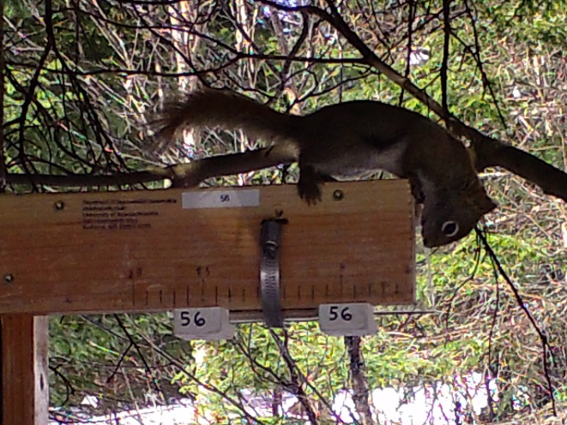
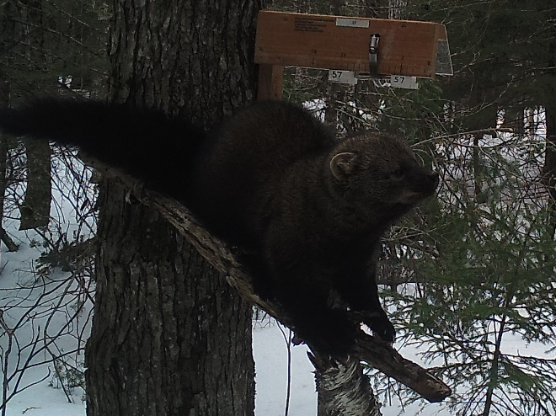
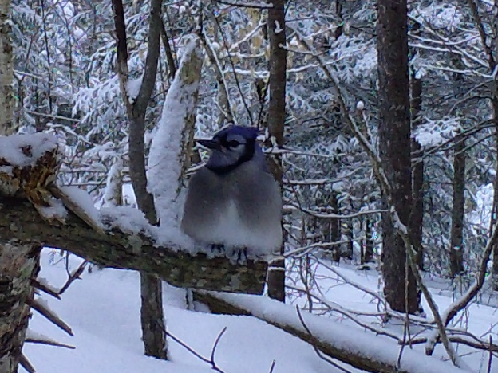
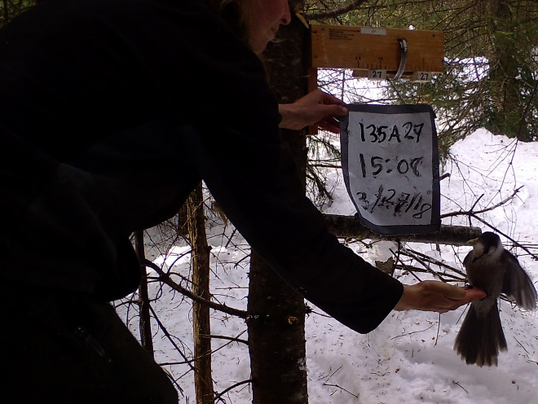
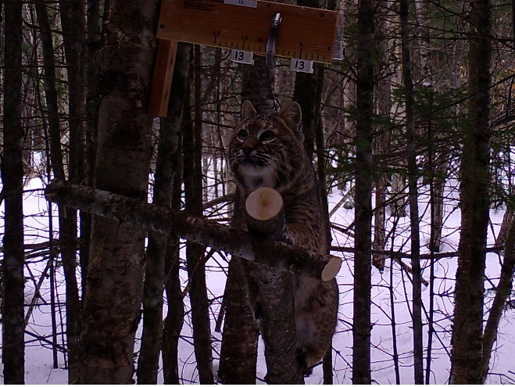
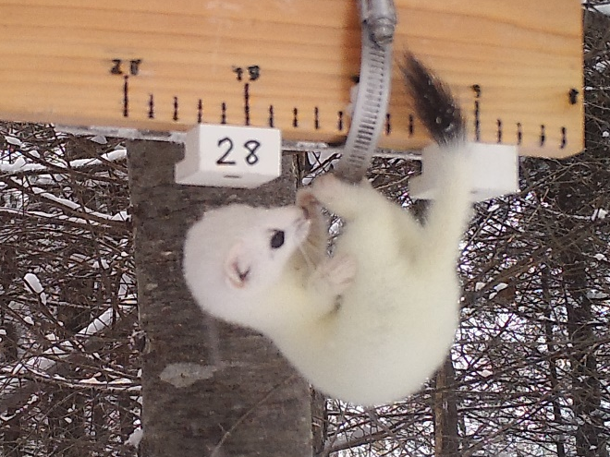
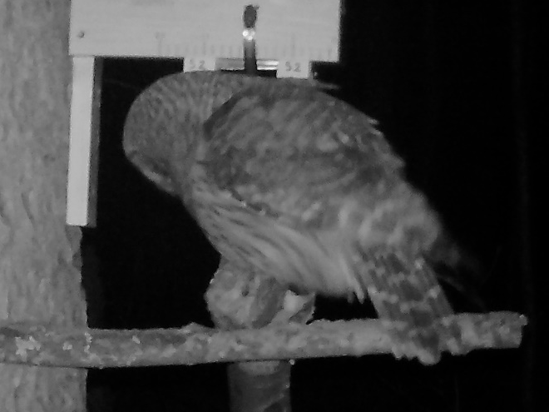

Slide 26

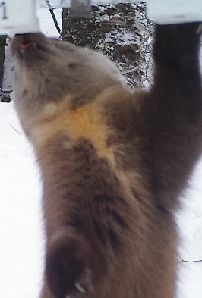
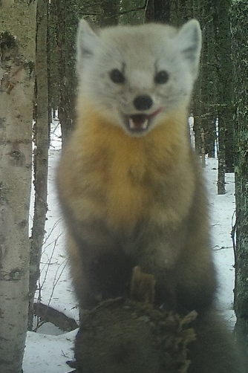
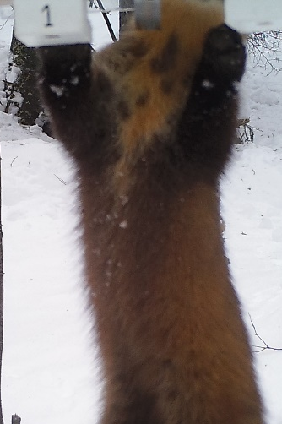
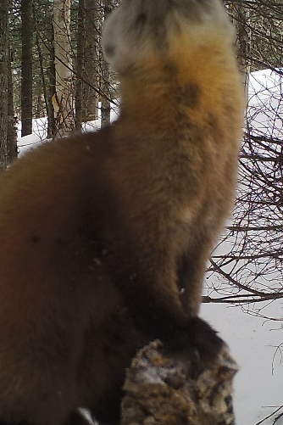
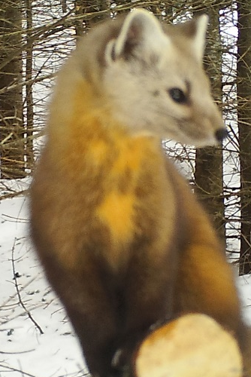
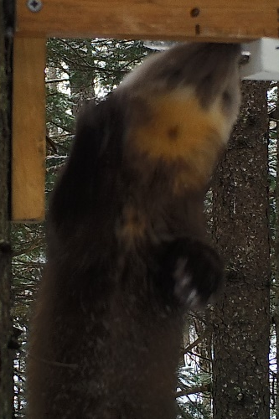
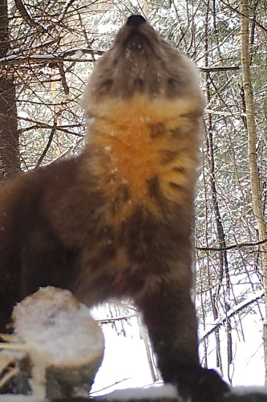
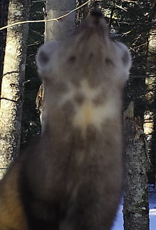
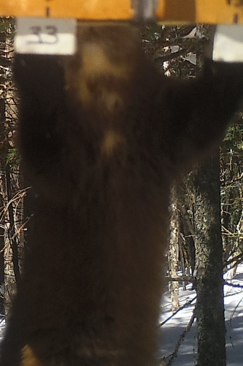

Monster
Phoenix
Africa
Tic Tac Toe
Stripe
Crossbow
Bullseye
Burst
Batty
Pacman
Christmas Tree

Slide 27


