Slide 1
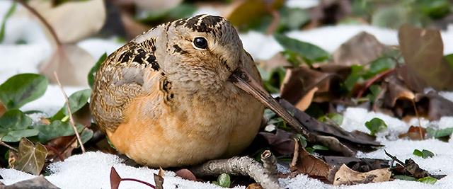

From keystone initiatives to landscape programs: a decade of investing in forest conservation for birds – outputs, outcomes and lessons learned
Scott Hall, Senior Scientist, Bird Conservation
Notes:
Good afternoon.
My name is Scott Hall, I am the senior scientist for bird Conservation at the National Fish and Wildlife foundation
In this talk I will introduce you to the foundation, to our conservation approach and I will provide an example of a forests program.

Slide 2
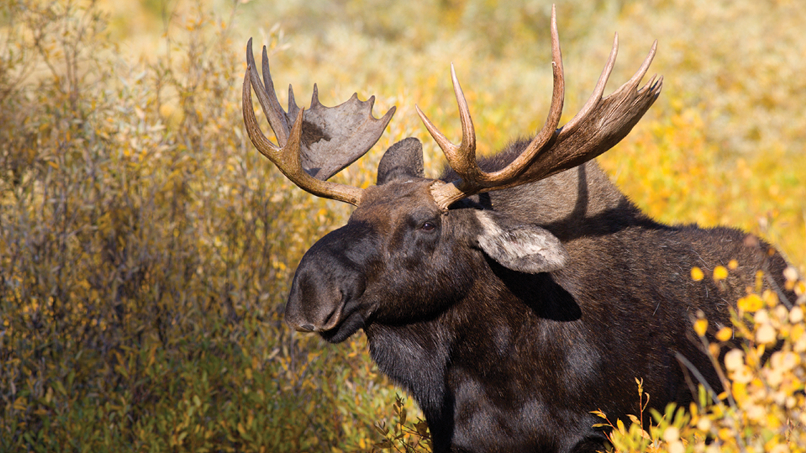
Who We Are
Chartered by Congress in 1984
What We Do
Facilitate collaboration and funding among federal agencies and private sector
NFWF is
An implementer – we fund projects through competitive RFP’s
NFWF is not
An advocacy organization that engages in lobbying or litigation
NFWF’s call to action
Develop long-term, science-based conservation programs with measurable outcomes that “move the needle” for key species, places of importance, or issues
Notes:
In the mid 2000’s; NFWF’s board asked staff to develop long-term, science based conservation programs with MEASURABLE outcomes that move the needle for key species and habitats.
This represented a fundamental shift from grant-making best-described as random acts of kindness to a more focused approach.
Ultimately this shift was the genesis of our keystone species programs and underlies the current landscape focused approach to conservation

Slide 3



SPECIES
PLACES
ISSUES
Low probability of persistence
OR
Conservation concern that play a key ecological role
Places of greatest national ecological importance
Issues driving declines in species of concern
NFWF ability to “move the needle”
Species are the metrics for measuring success
Needle movement measured as percent change toward population goals for indicator species
Preferred time frame 2 – 10 years
Cost-effectiveness
Incremental BENEFIT provided by project or initiative X NFWF effect
COST of project or initiative to NFWF
HUMAN VALUES, ECOSYSTEMS SERVICES, AND OTHER CONSIDERATIONS
KEYSTONE INITIATIVES

Slide 4
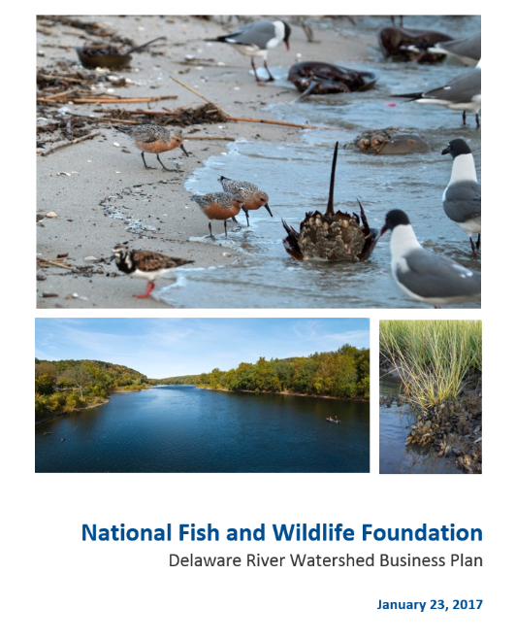
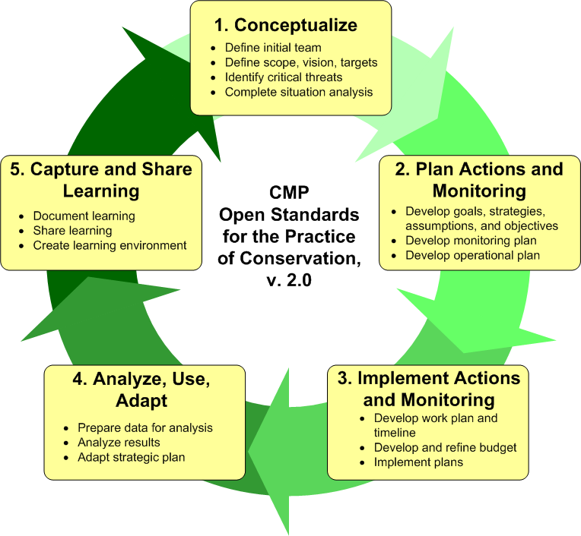
Development of a Business Plan
Description of conservation need, strategies, and funds required to achieve and monitor the desired conservation outcome
Notes:
Our science based programs were created in partnership with agencies, NGO’s, species experts and community stakeholders
Program development follows the open standards for the practice of conservation – a five step iterative cycle beginning with
identification of the issues and partners,
planning goals, actions, strategies and monitoring
Implementing projects and monitoring
Analyzing and assessing outputs to fine tune the approach
And sharing lessons learned.
NFWF articulates this process and these steps in “business Plans” – these are our roadmaps for implementing and assessing a conservation program – they articulate, threat or need, implementations strategies, funding and the desired outcomes

Slide 5
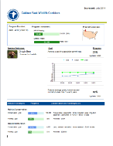
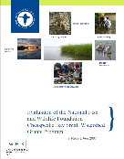
Evaluating results
  Annual Scorecards
  Internal Assessments
  Third-party evaluations
Notes:
Overall, in the open standards model an key step for the foundation is using project level outputs, for developing annual reporting (our scorecards) and for conducting assessments/evaluations to track program progress and ask questions about performance.
The last step in the model is to capture learning and share information in part to inform future planning efforts.

Slide 6
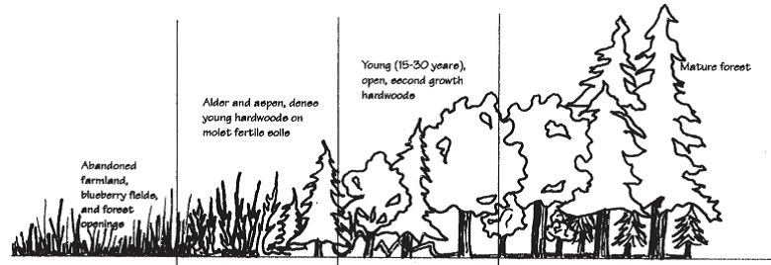
Early successional forest keystone – then & now
Planning & Implementation (2008)
Dozens of species in decline for more than 40 years
Habitat loss a primary threat
Core strategy: restore and create early successional forest
Continental bird population goals established – (SGS;BBS) for
assessing progress towards goals.
Notes:
NFWF’s initial focus on forests began with a business planning effort in 2008.
The focus on esf habitats was due to both observed declines in species that require the habitat for portions of their annual life cycle and confirmation that loss of this habitat on the landscape was a primary driver of population change.
Primary strategy was to create and restore ESF habitat across a 17 state region from Maine to Minnesota and south to Virginia.
Planning documents set continental bird goals for two species, (AMWO and GWWA)

Slide 7
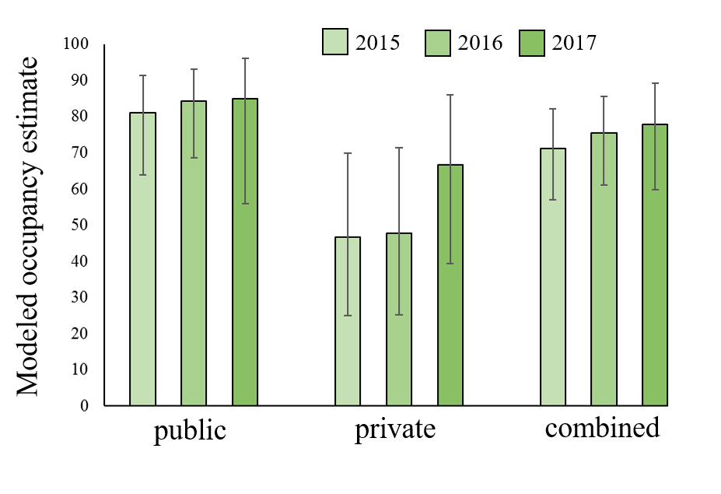
Early successional forest keystone – then & now
Assessment & learning (2015/16)
Initiative successful creating habitat (>850,000 acres)
“If you build it, they will come” – SITE MONITORING
Challenge to assess bird population change at scale –DATA!
Bird community advocates “ broader forest strategy”
  Forest age and structural diversity
Notes:
In 2015, at the approximate midpoint of the program our evaluation team conducted an assessment to better understand progress toward program goals and understand any challenges.
Results of the assessment included
Validation that partners had been successful creating habitat
and that birds and wildlife will occupy this newly created habitat
We also learned that rolling up results to assess broader population change is a significant challenge
And importantly we learned that our partners and stakeholders were exploring a broader forest strategy focused on increasing age and structural diversity within forest stands.

Slide 8
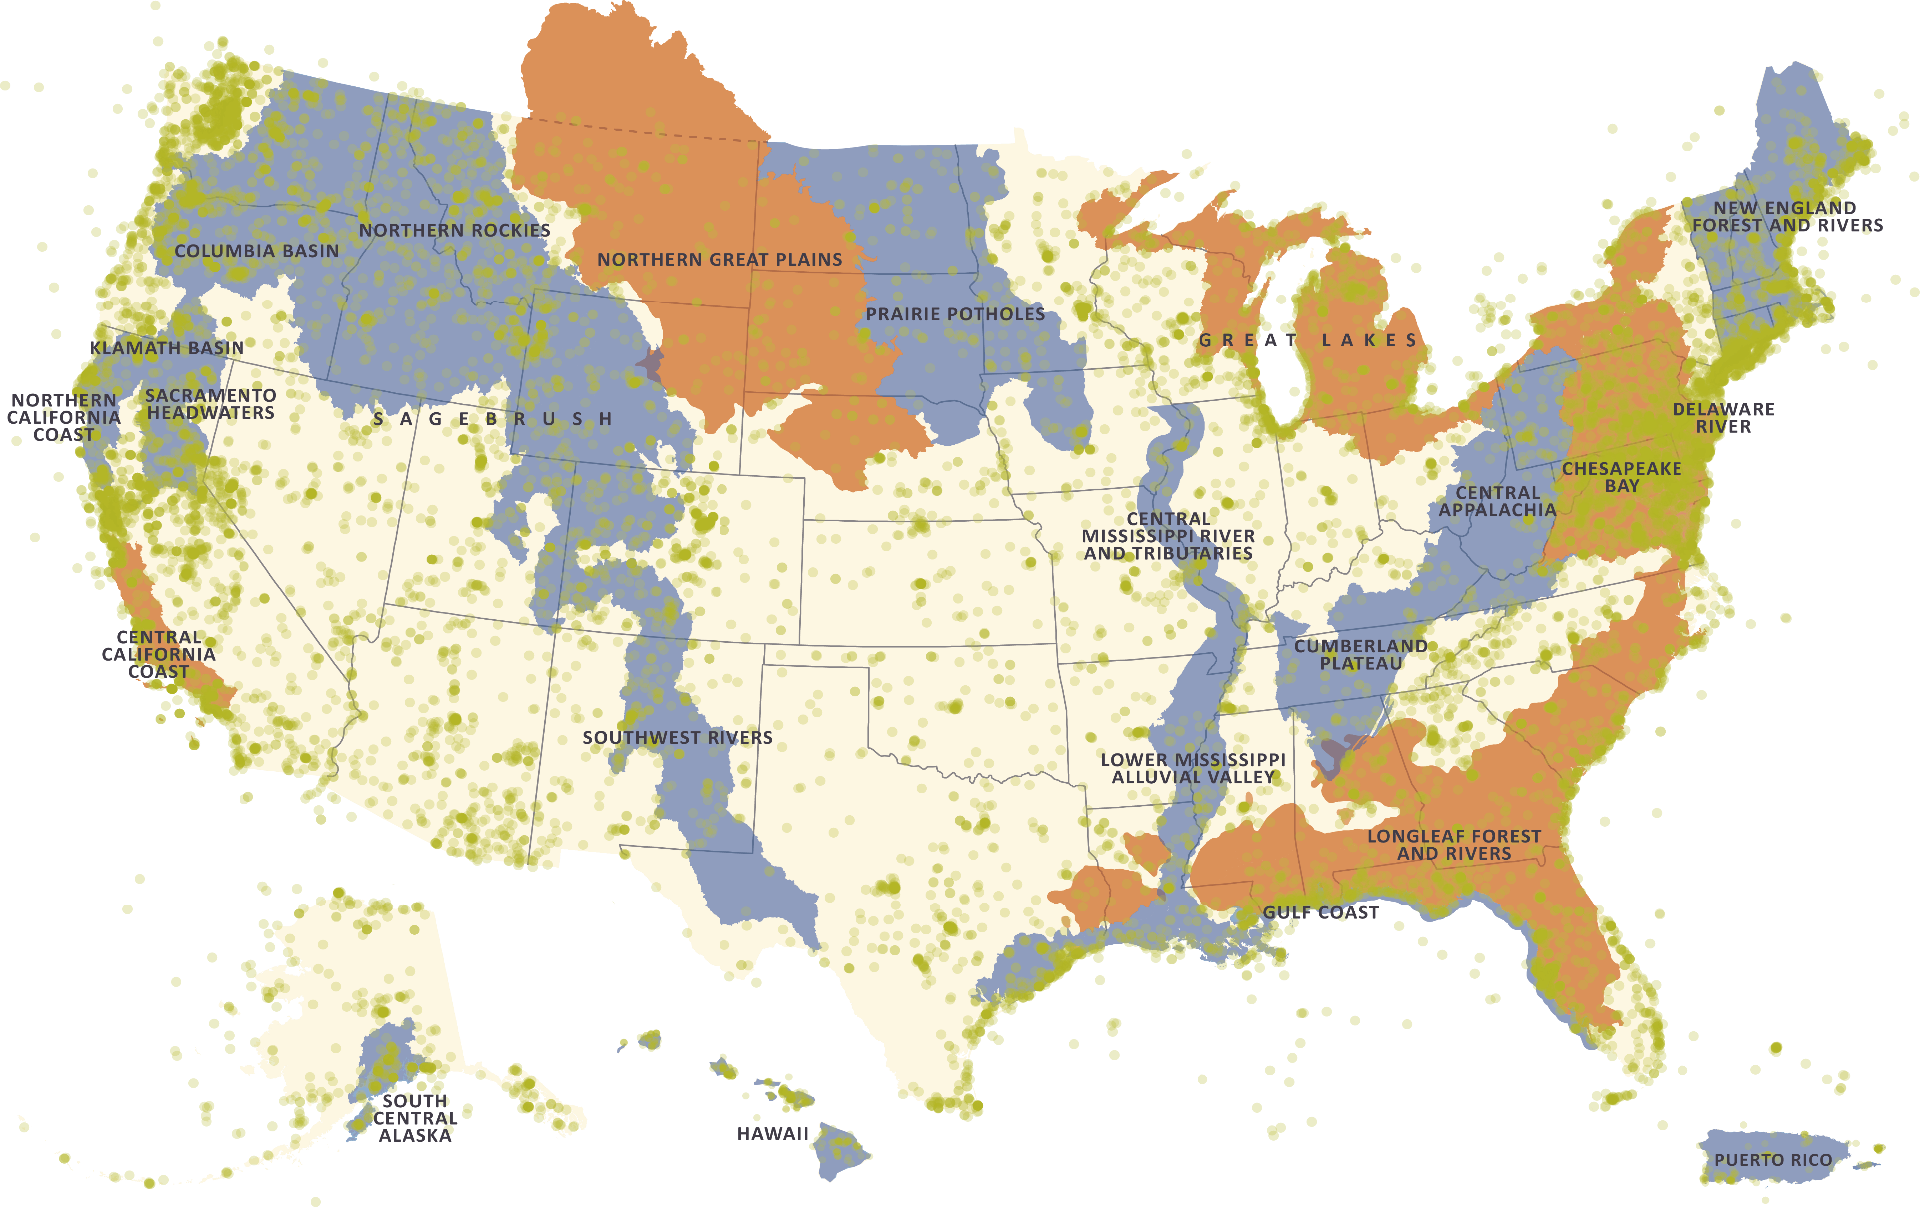
Moving to Landscape conservation – Eastern forests
Notes:
The next part of this presentation is focused on an example that wraps our approach into a single story that capture aspects of planning, metric selection, measuring performance, adjustment and monitoring.
The following example, is focused on the eastern hardwood forest; Within this system NFWF has supported three former keystone initiatives focused on early successional habitat and we are currently working with stakeholders and partners in four landscapes.

Slide 9
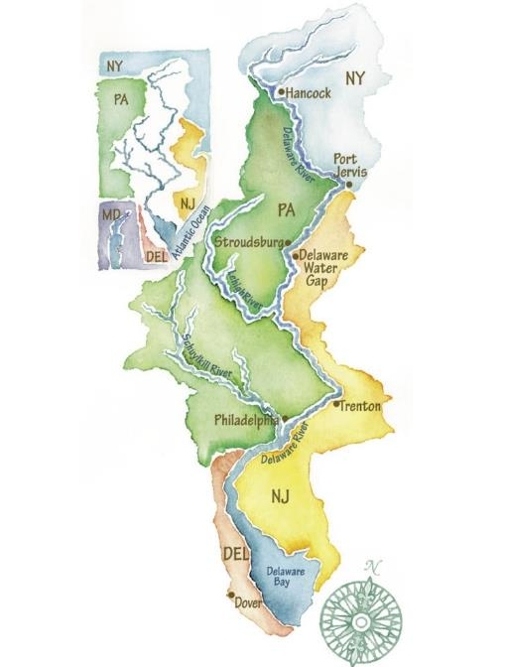
Next step: Delaware River Watershed – a new landscape
13,539 square mile watershed in four states
Critical habitat for migratory and resident fish and bird species
Source of drinking water for over 15 million people
Notes:
The resulting output of the evaluation was a change in strategy.
In November 2016, the NFWF board approved exit from the ESF Keystone Initiative
The Delaware River watershed is our first foray into managing forests for multiple age classes.
Focus on “block” forest management to improve age and structural diversity
Support development of new monitoring framework/reporting tools to inform species response/assessment at scale

Slide 10
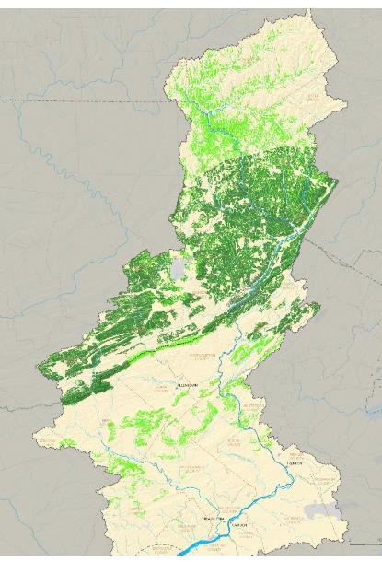
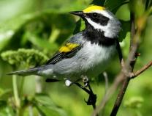
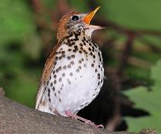
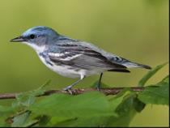
Forest bird priorities
Forest blocks that are
At least 2,500 -5,000 acres
Priority habitat for bird species
Golden-winged Warbler
Wood Thrush
Cerulean Warbler
Notes:
To capture the benefit of managing forests for age and structural diversity changes, NFWF and stakeholders selected three focal bird species, each indicative of a different forest condition 1) GWWA = ESF; 2) WOTH = structured mature forest; 3) CEWA = LS (open canopy forest).
Forest management projects will be focused on contiguous forest blocks of at least 2500 to 5000 acres that are priority habitat for focal bird species..
The map in the center is a product of a modelling exercise; the darker green are the opportunity areas for implementing forest management to benefit target bird species
Also screening projects to find synergies between water (cold headwater streams) and forest management

Slide 11
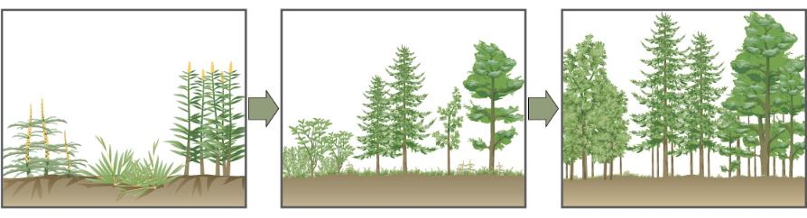
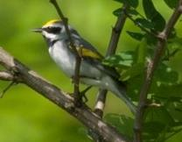
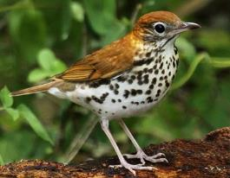
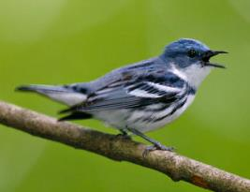
Delaware program bird/habitat goals:
Early Successional Forest
Mature Forest
Late Successional Forest
375 to 500 acres
750 to 1,500 acres
750 to 1,500 acres
Golden-winged Warbler
Wood Thrush
Cerulean Warbler
40+ breeding territories
60+ breeding territories
180+ breeding territories
Notes:
With partners and stakeholders generalized acreage goals were set for each block (at minimum 10-15% of the block will be in ESF)
With the acreage targets set – in consultation with species experts established bird goals were established. These were generated from data using average territory size for each focal species to develop an expected number of territories for each habitat type. Bird goals here are based on minimum acreage values.
Fundamental to all of this work is the ability to extend monitoring to the entire managed block

Slide 12
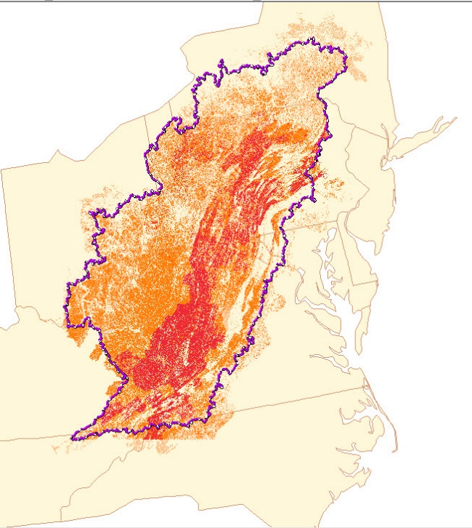
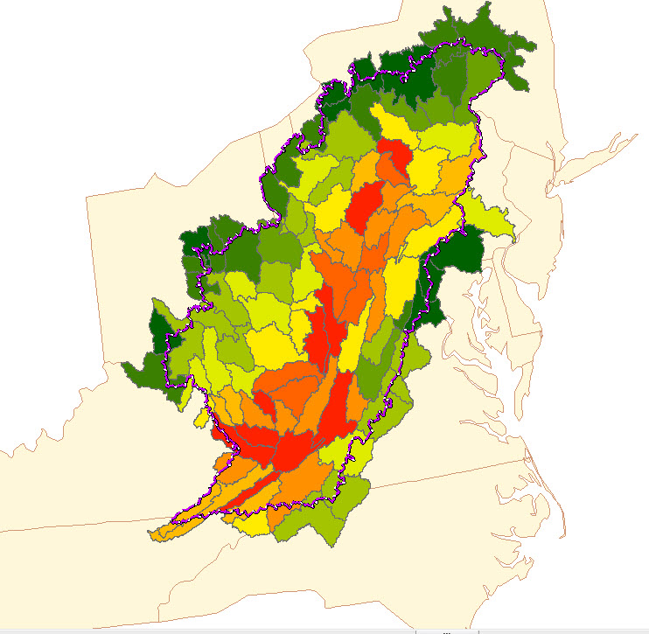
Central Appalachia: expanding the block management concept
Early Successional Forest
Mature Forest
Late Successional Forest
3,600acres
15,000 acres
11,400 acres
Golden-winged Warbler
Wood Thrush
Cerulean Warbler
275 breeding territories
1,200 breeding territories
2,700 breeding territories

Slide 13
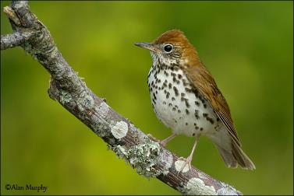
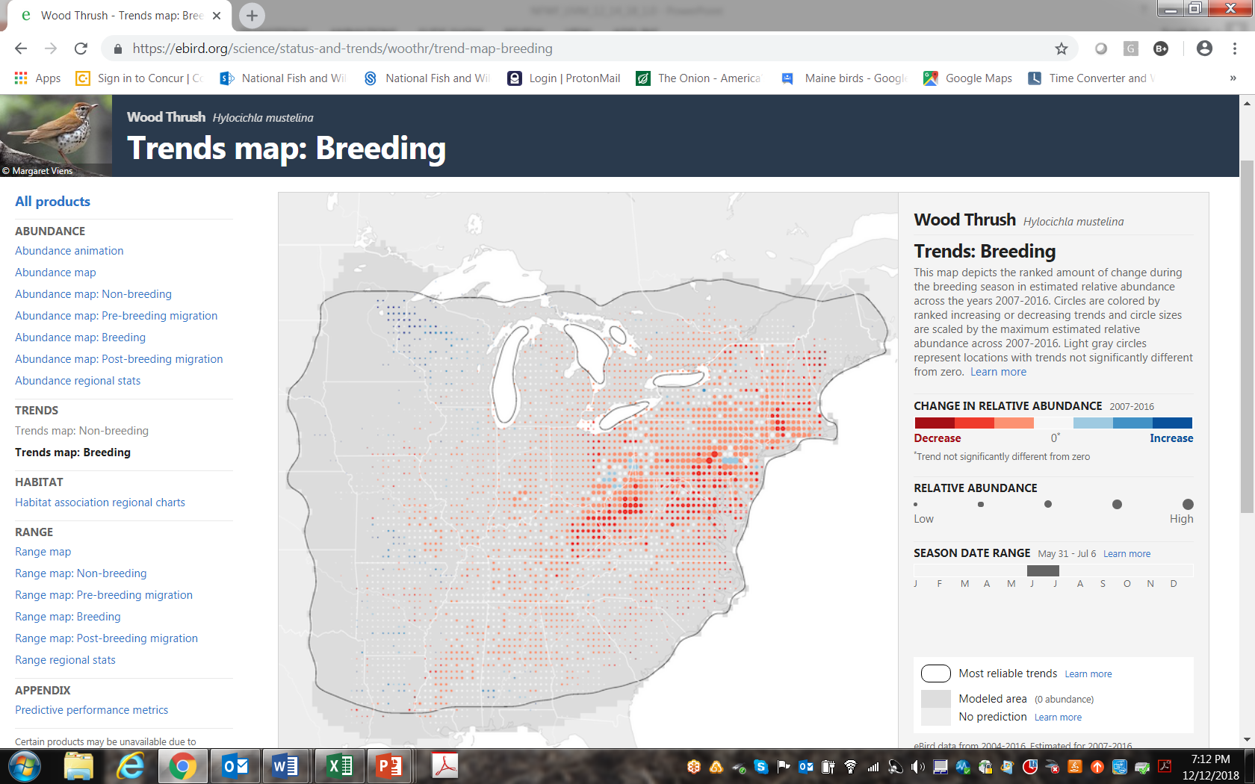
Next steps
  Evaluate whether managing for forest age and structural diversity results in changes in bird abundance (local effect)
  Develop monitoring frameworks to assess landscape response
  Develop a cost efficient monitoring program
  Develop common metrics/measures of success for birds to
    evaluate impacts across NFWF landscapes
    better understand national impacts on bird conservation
Notes:
With this program we expect to answer several questions with data outputs including
Evaluate whether managing for forest age and structural diversity results in changes in bird abundance (local effect)
Develop monitoring frameworks to assess landscape response
Develop a cost efficient monitoring program
Develop common metrics/measures of success for birds to
evaluate impacts across NFWF landscapes
better understand national impacts on bird conservation

