Slide 1


Continuous Forest Inventory Across Vermont State-owned Land in the Northeast Kingdom
Vermont Department of Forests, Parks & Recreation
Vermont State Lands Forester, Emily Meacham

Slide 2
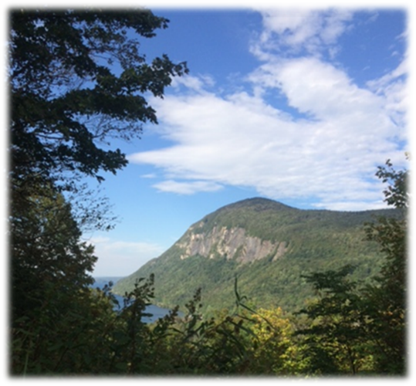
Overview
  Vermont State Lands forester
  Continuous Forest Inventory (CFI)
  CFI Location, Stratification, and Plot Density
  Plot Design
  Metrics
  VMC Database
Viewpoint near a 2016 established CFI Plot at Willoughby State Forest

Slide 3
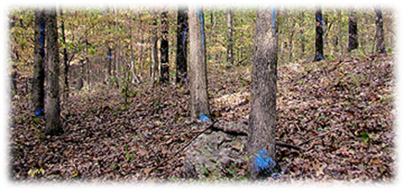
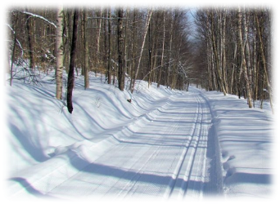
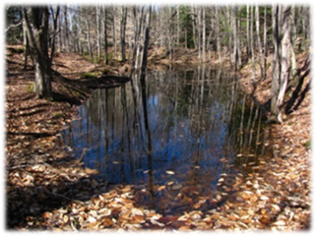
Vermont state Lands Forester
Administer timber harvests
Contract road maintenance and pioneering
AMP/heavy cut technical assistance
Assist with:
  recreation
  wildlife habitat management
  research
  outreach
  planning

Slide 4
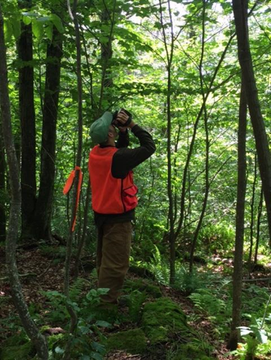
Importance of CFI
CFI is:
a set of permanent plots that serves as a comprehensive measure of tree growth, mortality, decay, and ingrowth.
Data collected from CFI allows managers to:
Understand changes in the forest ecosystem.
Understand how fast the forest is growing.
Understand the rate at which disturbance events (wind, harvest, etc.) cause trees to die.
Better apply silvicultural treatments.
Gavin Cook (CFI intern 2015) measuring tree height in Victory

Slide 5
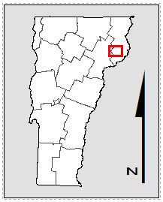
CFI Location … so far!
Willoughby State Forest
Year 2 – 2016
33 plots established
Interns Isaac Estey and Jacob Miller
Victory Management Unit
Year 1 – 2015
50 plots established
Interns Ethan Goss and Gavin Cook

Slide 6
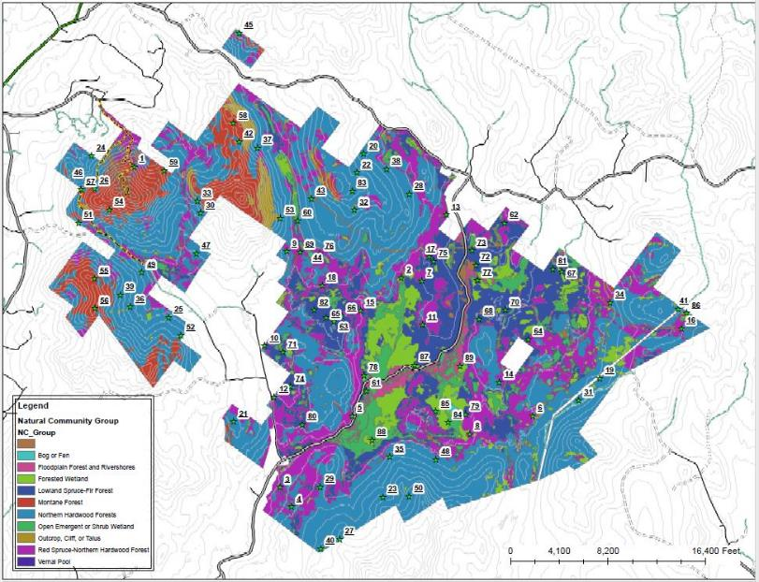
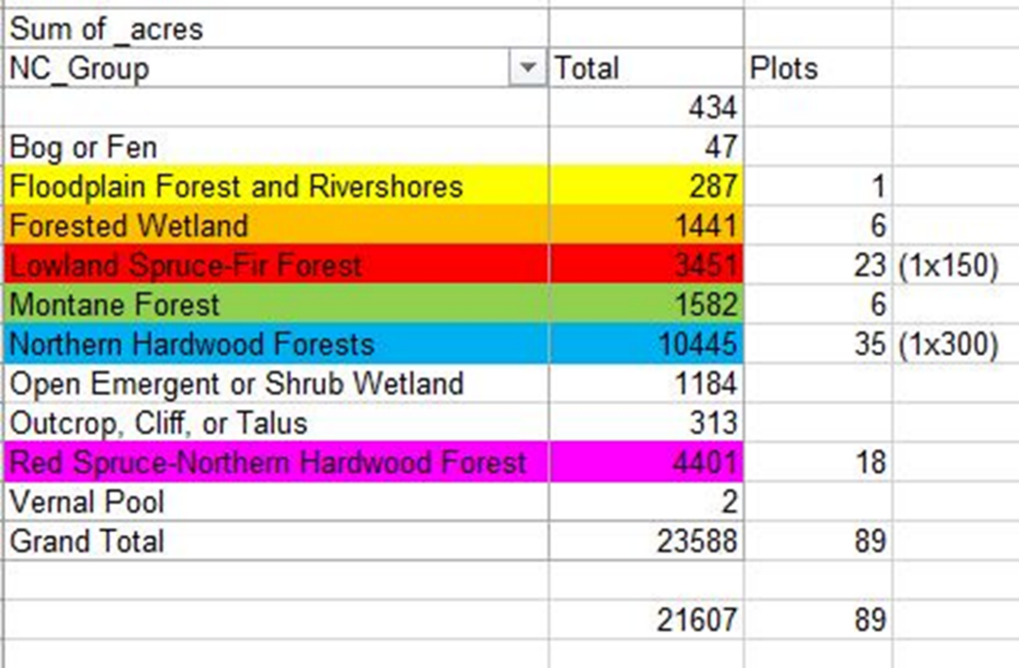
CFI Location, Stratification, and Plot Density: Victory Management Unit
Victory Management Unit
~ 24,000 Acres
Includes: Victory Basin Wildlife Management Area, Victory State Forest, and Darling State Forest Park
Stratified by Natural Community
Focus Area: Lowland Spruce-Fir Natural Community

Slide 7

CFI Location: Willoughby State Forest
Willoughby State Forest
~ 8,000 acres
Stratified by Natural Community (mostly northern hardwood forest)

Slide 8
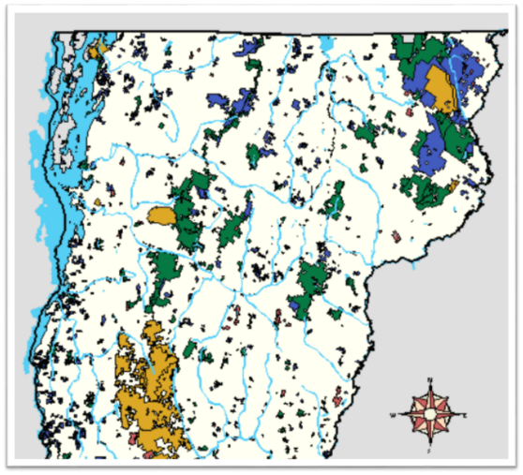
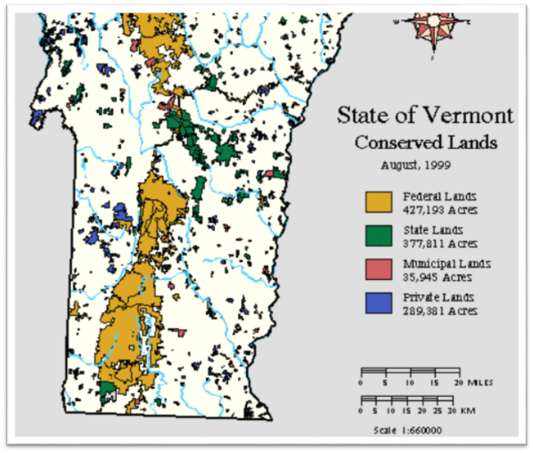
CFI Location: Where Next?
~350,000 acres
~1500 plots @ 1 plot per 225 acres
5 teams of 2 interns
~ 4 years of 12 week summer internships

Slide 9
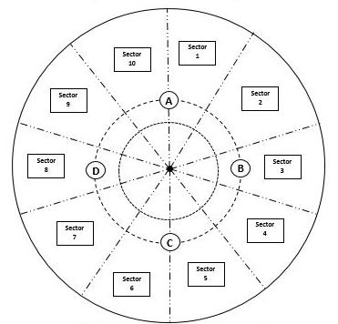
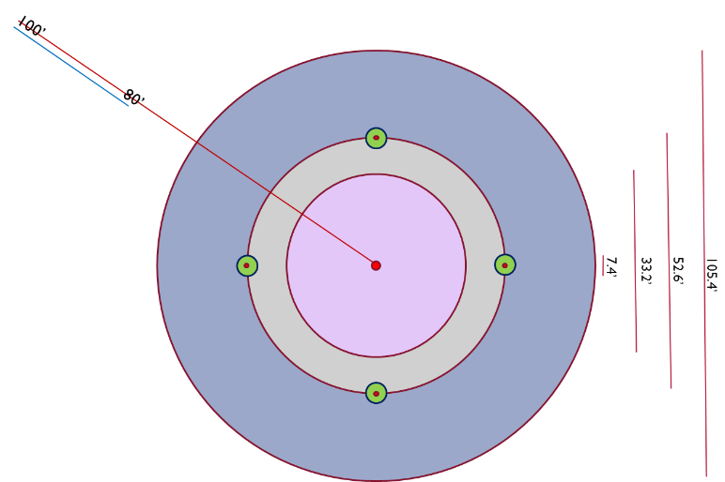
CFI Plot Design
Overstory Trees ≥ 4.5” DBH
1.0” DBH ≤ Small Saplings < 2.5” DBH
Seedlings < 4.5’ tall, seedlings ≥ 4.5’ tall and < 0.5” DBH
2.5” DBH ≤ Large Saplings < 4.5” DBH
CWM >2.9” (@intersection) and 2.9’
Image by Ethan Goss (CFI Intern 2015)

Slide 10
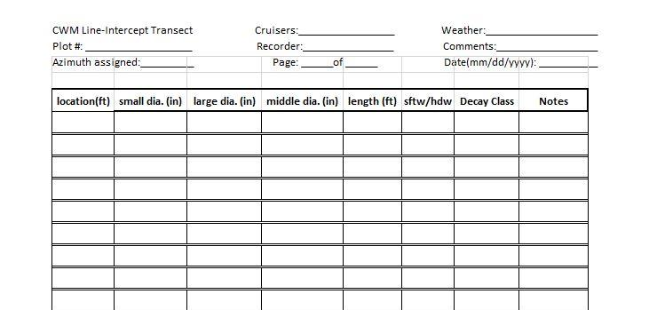
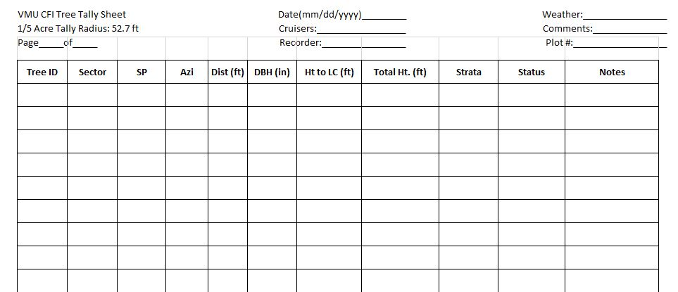
CFI Metrics

Slide 11
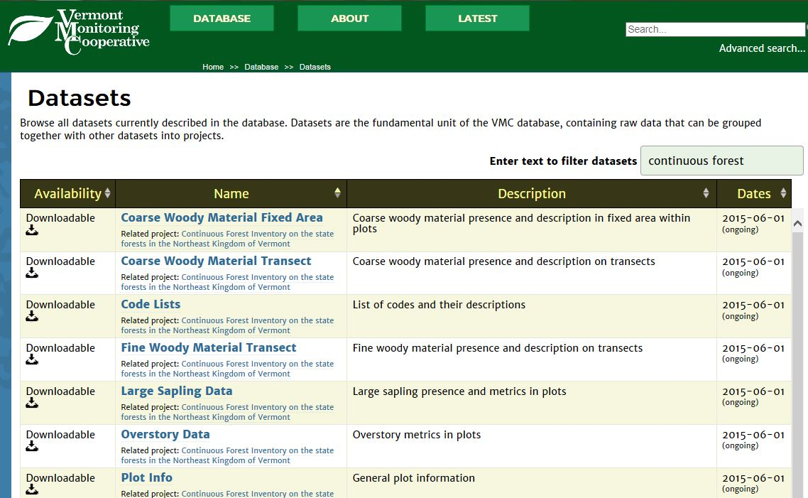
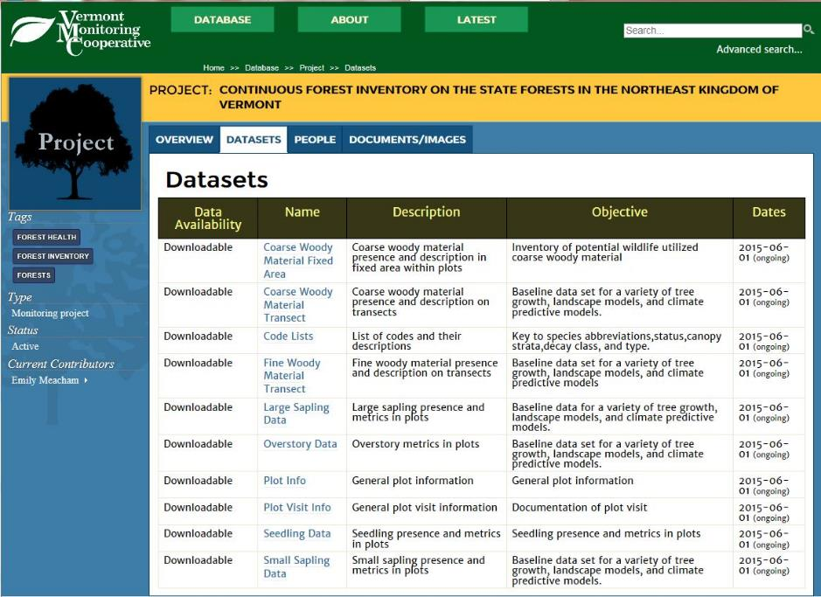
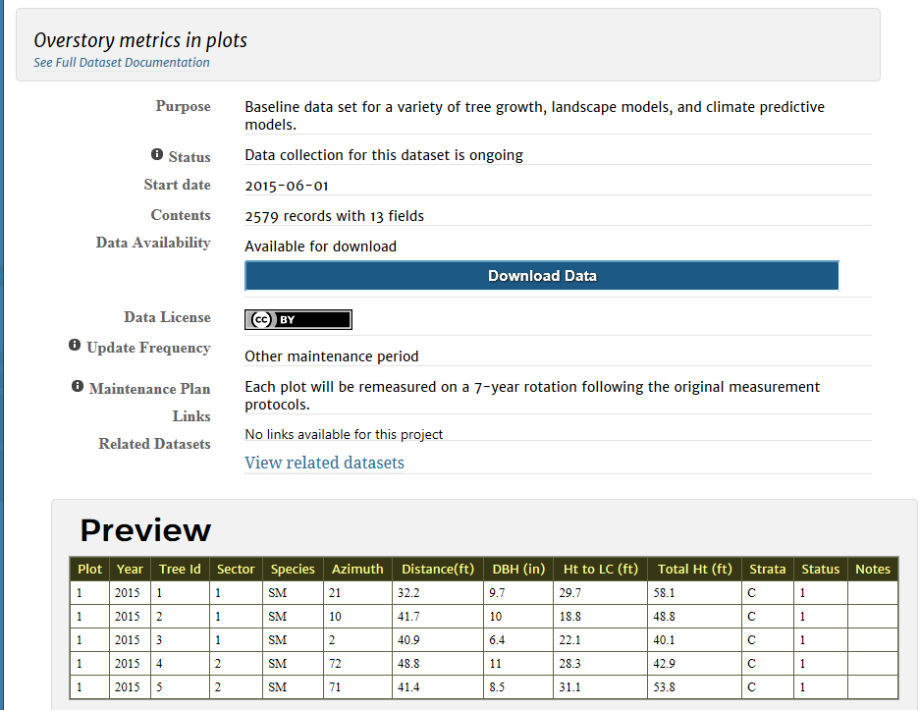
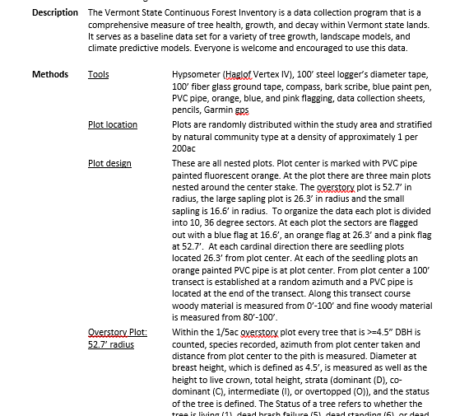
VMC Database

Slide 12
Acknowledgements
Waskiewicz, Justin D.; Kenefic, Laura S.; Rogers, Nicole S.; Puhlick, Joshua J.; Brissette, John C.; Dionne, Richard J.; April 2015. Sampling and measurement protocols for long-term silvicultural studies on the Penobscot Experimental Forest. US Forest Service Northern Research Station. General Technical Report NRS-147.
Curtis, Robert O. and Marshall, David D.; April 2005. Permanent-Plot Procedures for Silvicultural and Yield Research. US Forest Service Pacific Northwest Research Station. General Technical Report 634.

Slide 13
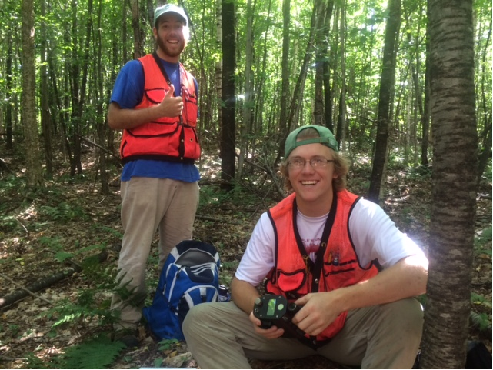
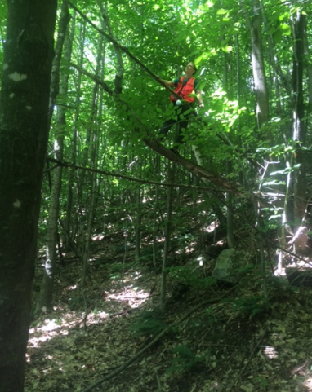
Acknowledgements
UMaine Demerritt Forest, Penobscot Experimental Forest, BSP SFMA
Professors Anthony D’Amato, Aaron Weiskittel, Bob Seymour
District V Forestry Staff
Green Mountain Club
Isaac Estey and Jacob Miller
Gavin Cook and Ethan Goss

Slide 14
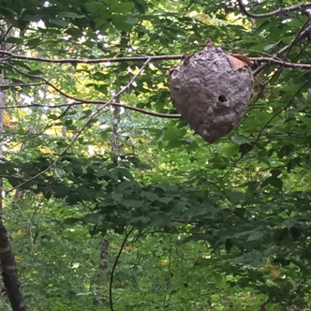
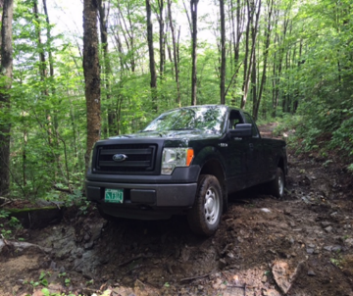
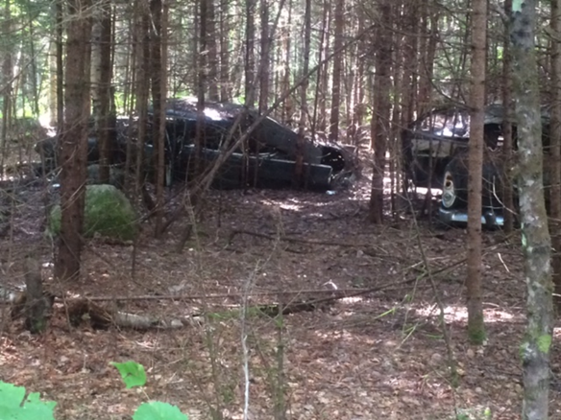
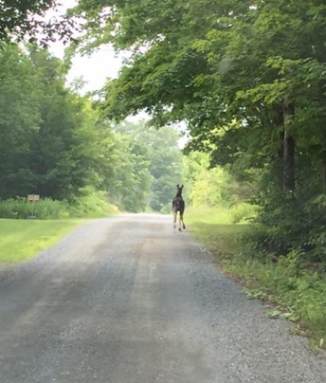
Thank You
Questions or comments?
emily.meacham@vermont.gov
(802) 595 - 0169

