Slide 1
Forested Riparian Buffers
science and practice
Karl Honkonen
Watershed Forester
US Forest Service
Northeastern Area State and Private Forestry

Slide 2
Presentation Overview
US Forest Service NA/State & Private Forestry
Buffer science
How are we doing?

Slide 3
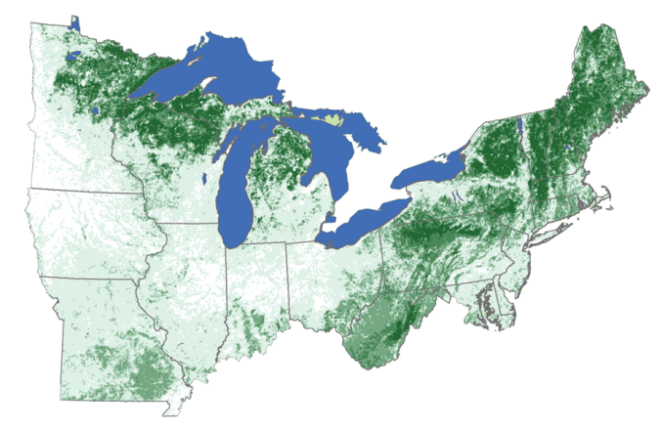
US Forest Service Northeast Area
Notes:
Green on the map represents forest land.
The most heavily forested and densely populated region of the US
172 million acres of forest land
125 million people (41 % of the U.S. population)
Approximately 50 -75 % of the Area’s population relies on surface water as their municipal drinking water source
Over 52 million people receive clean drinking water from nearly 1,600 community water systems.
KEEP FORESTS AS FORESTS!

Slide 4
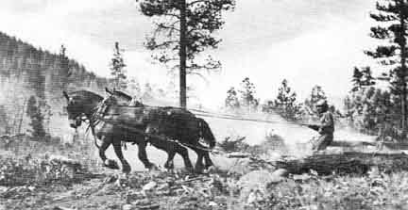
The roots of the Forest Service are in Watershed Management
Around 1900 America’s settlers cleared forests at the rate of 13 square miles per day
Notes:
Massive clearing of forestland for agriculture continued into the 20th century.
For example, in the last 50 years of the 19th century, forest cover in many areas east of the Mississippi had fallen from 70 percent to 20 percent or less.
From 1860-1910, settlers cleared forests at the average rate of 13.3 square miles per day - much of this land included highly erosive steep slopes.

Slide 5
White Mountain National Forest
Notes:
The White Mountain region of NH saw mountainsides stripped of trees from what was once virgin forest
streams choked with silt from eroding hillsides and ash from forest fires falling on nearby towns
Factory owners relying on waterpower worried about the flooding that occurred after heavy rains and the low flows during summer droughts.
Hotel owners heard the complaints of tourists who did not like the blackened slopes and streams choked with sawdust and silt.
WMNF was established in 1918 as a result of the Weeks Act (MA Congressman). It has a total area of 780,000 acres.

Slide 6
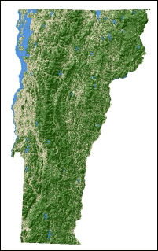
http://www.nrs.fs.fed.us/fia/data-tools/state-reports/VT/
Notes:
VT is +/- 75% forested, as seen by recent FIA data.
Landscape Scale Restoration (LSR) Grants helps State Forestry agencies achieve priorities as documented in their respective state forest action plans while at the same time meeting regional and national priorities. One VT Forest Action Plan goal is to protect high quality watersheds, shorelines & riparian areas.
Random BMP (AMP) monitoring (CWA exemption) as an important indicator of sustainable forest management practices (timber sale layout, stream crossings, skid roads, landings, HazMat management
80-90% OK in states like VT and ME that have very organized programs. Logger education and skidder bridge loan programs help a great deal. Keep sediments out of streams!

Slide 8
Notes:
Rain is absorbed and slowed by trees and the forest floor before it reaches local streams, flows to rivers and ultimately Lake Champlain and other surface water bodies.

Slide 9
Notes:
Forests essentially act as a living sponge – water gets absorbed, filtered, and released to the forest floor – ultimately refilling underground aquifers and helping to maintain stream flow.

Slide 10
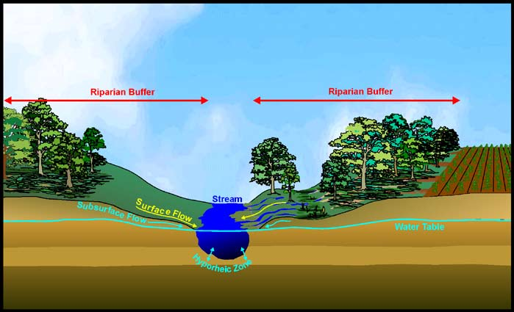
What is a riparian buffer?
Notes:
area of land located immediately adjacent to streams, lakes, or other surface waters. Some would describe it as the floodplain. The boundary of the riparian area and the adjoining uplands is gradual and not always well-defined. However, riparian areas differ from the uplands because of high levels of soil moisture, frequent flooding, and the unique assemblage of plant and animal communities found there.
Under the current representation of riparian buffers, a buffer is a newly established area along a stream, on average 100 feet wide, of either grass or trees, and is managed to maintain the integrity of stream channels and shorelines and reduce the impacts of upstream land uses. Both grass and forest buffers that are at least 35’ wide receive credit. This is part of USDA’s standard practice definition (e.g., Practice 391) to receive cost share.

Slide 11
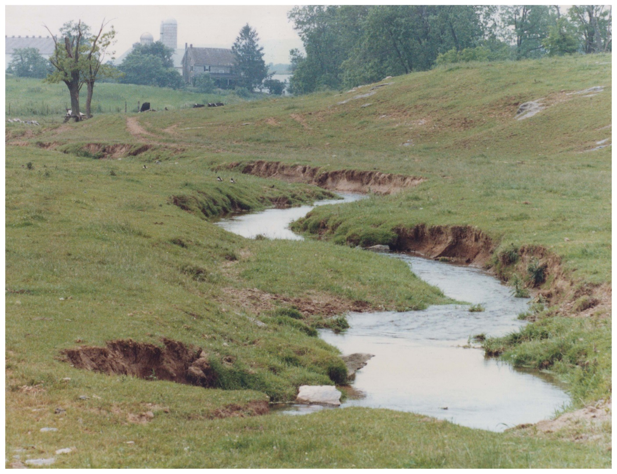
Why forested riparian buffers?
Notes:
most pollutants result from nonpoint source pollution activities, including runoff from agricultural lands, urban areas, construction and industrial sites, and failed septic tanks
contaminants are taken up into plant tissues, adsorbed onto soil particles, or modified by soil organisms.
forest and grass riparian buffers can effectively trap sediment which may contain Phosphorous! Phosphorus most often enters the stream adsorbed into soil particles and organic materials in surface runoff after storm events.
Buffers may be most effective at removing large particles such as sand, but may be less effective at removing small clay particles.
Buffers create habitat by shading streams and creating cover for aquatic organisms. They provide litter fall and large wood important to fish and other aquatic organisms
Overhanging trees help moderate peak daytime temperatures.
Woody vegetation provides food, cover and connectivity for wildlife
Slows out-of-bank flood flows. woody roots increase the resistance of streambanks and shorelines to erosion caused by high water flows or waves.

Slide 12
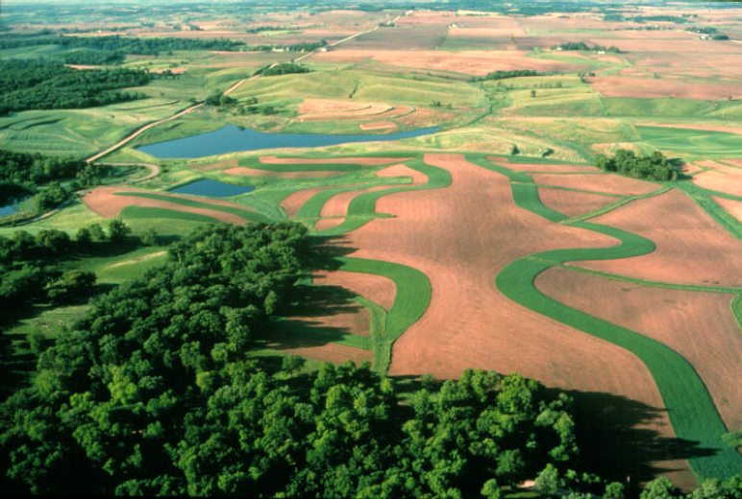
Notes:
Researchers at Virginia Tech found that orchard grass filter strips 30 feet wide removed 84 percent of the sediment and soluble solids from surface runoff, while grass strips 15 feet wide reduced sediment loads by 70 percent (Dillaha and others 1989).

Slide 13
Relative Water Quality Benefits

Slide 15
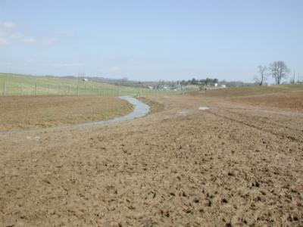
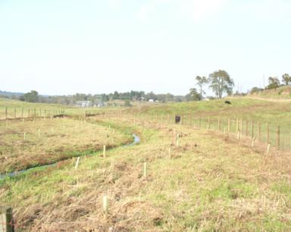
before
after
Another fully restored buffer!

Slide 16
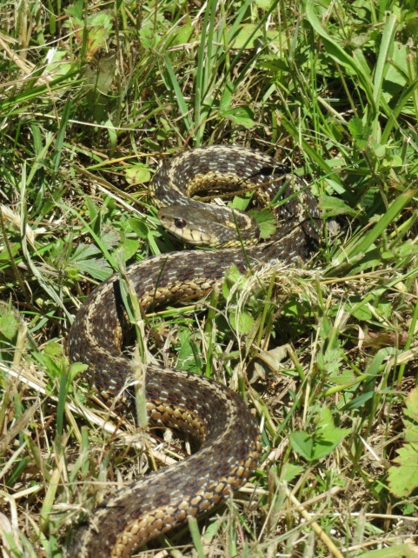
Logistics
Implementation
Who is out there to plant 1,000s of trees?
Maintenance
Where is the $ to maintain?
Who is responsible?
Education!!!

Slide 17
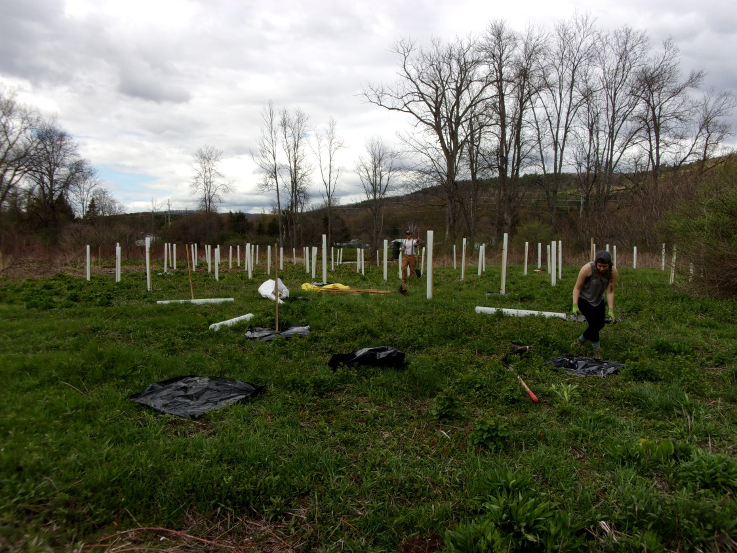
Oaks Creek- Otsego County
Notes:
Using student volunteers from SUNY Oneonta, about 700 trees and shrubs (about 2 acres) were planted along Oaks Creek in Otsego County. The land was old farm land no longer in production.

Slide 18
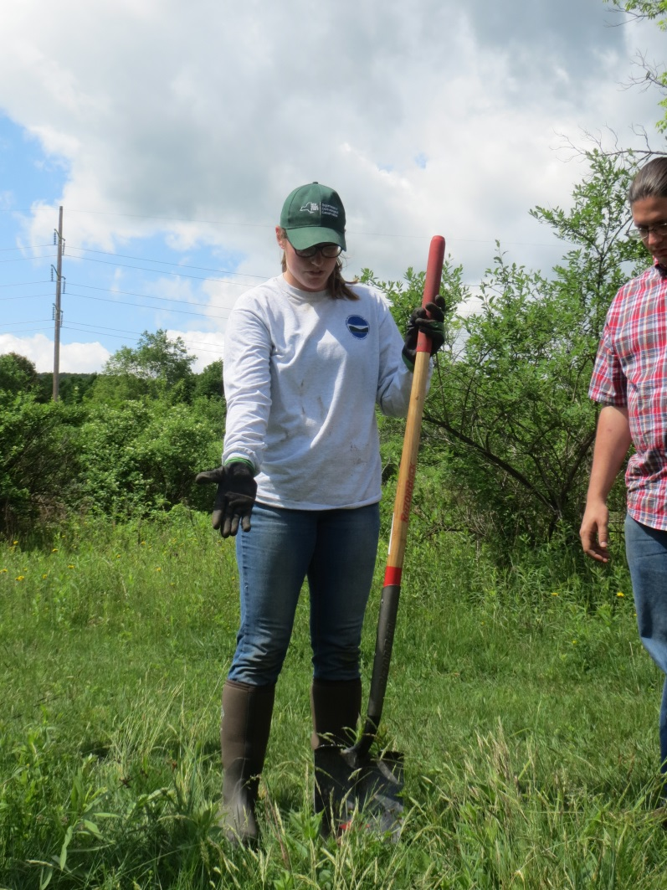
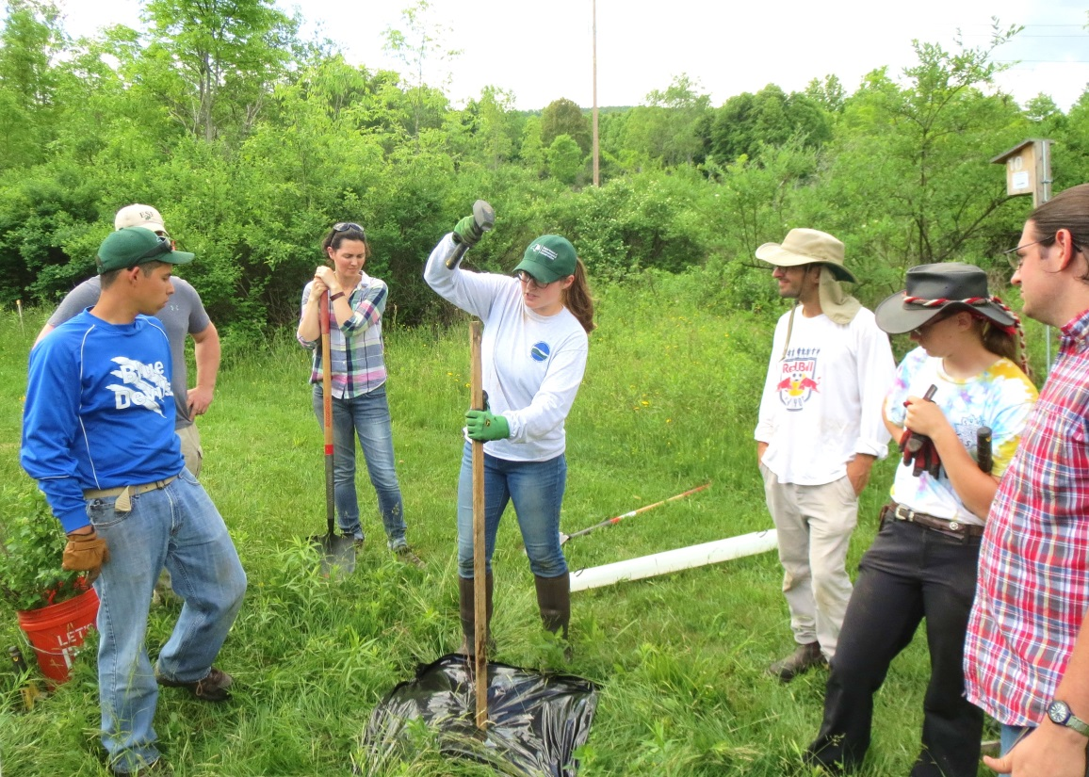
Maintenance and Planting Team 2016

Slide 19
Notes:
Oaks Creek Project After Picture

Slide 20
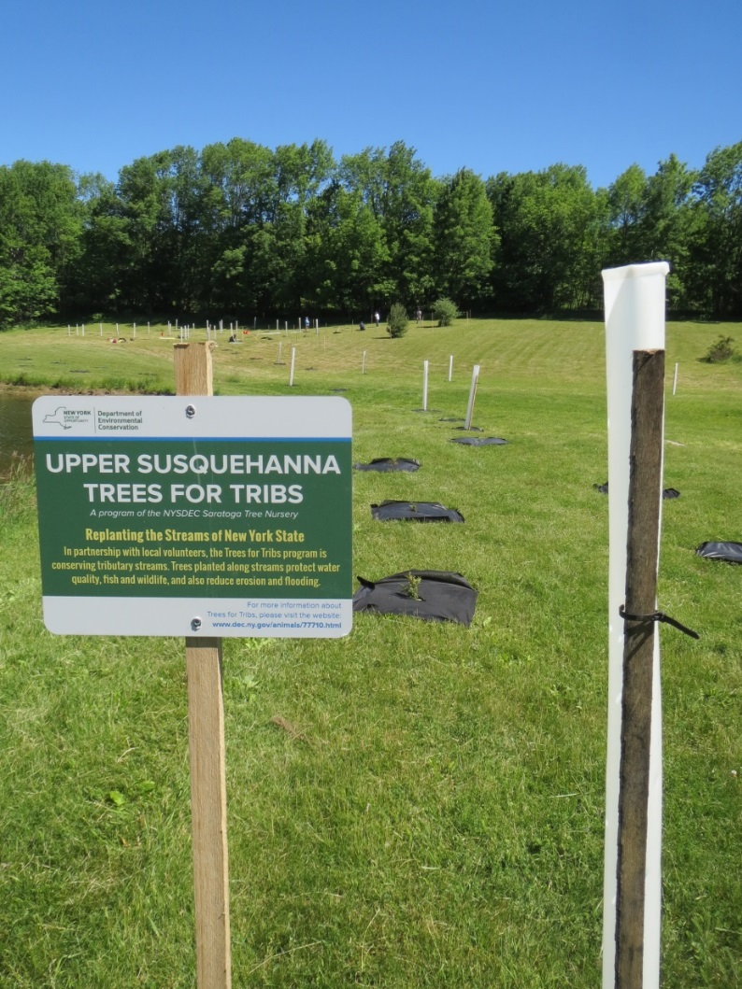
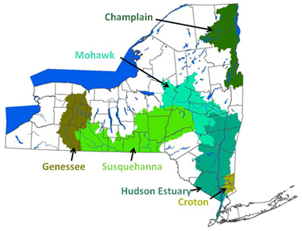
Notes:
NY Trees for Tribs has engaged more than 7,600 volunteers in planting more than 66,000 trees and shrubs at 470 sites across New York State.
Provides landowners, municipalities, and conservation organizations with low-cost or no-cost native plants and free technical assistance. Native bare root trees and shrubs are provided by the Saratoga State Tree Nursery

Slide 21
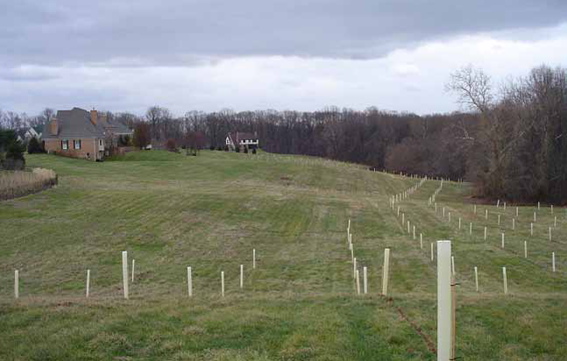
Turf to trees: Reforesting residential lawns

Slide 22
Conservation Reserve Enhancement Program
USDA Farm Service Agency
(NRCS technical assistance)
Great $$ incentive for landowners
cost-share to install + yearly payments
Limiting factor often outreach and technical assistance
Notes:
Stable streambank
10-15 year contract
Minimum 35’ buffer
There has to be a resource concern to get grazing system components (ex: cows in the stream)
Buffer needs to be maintained!!!

Slide 23
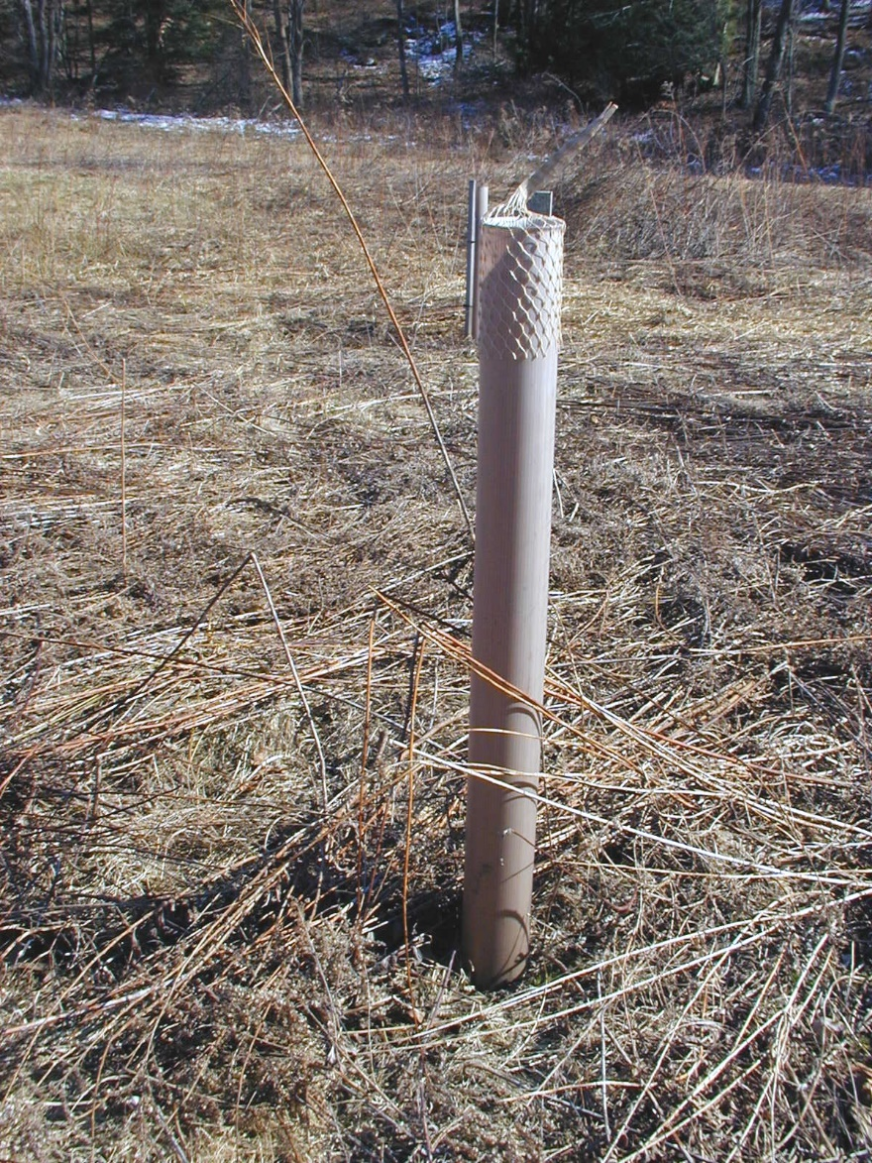
Maintenance
Monitoring
Mowing
Herbicides
Fencing
Notes:
Maintenance is critical to successful establishment of forest buffers, as with any best management practice. Studies have shown that weed control in the first 2-3 years are essential for success.
1x herbicide inadequate
Grass competition
Damage by voles
Deer damage even w/ 4’ shelters
Weak maintenance by landowners

Slide 24
FSA
CREP Program, $$
NRCS
Landowner Contact,
Technical Assistance
Forest Buffer
Restoration
USFS
Coordination,
Grants
Agency Partners
State, federal
Conservation districts
Other Partners, watershed organizations, etc.
State Forestry
Forestry Assistance,
Tracking, Projects

Slide 25
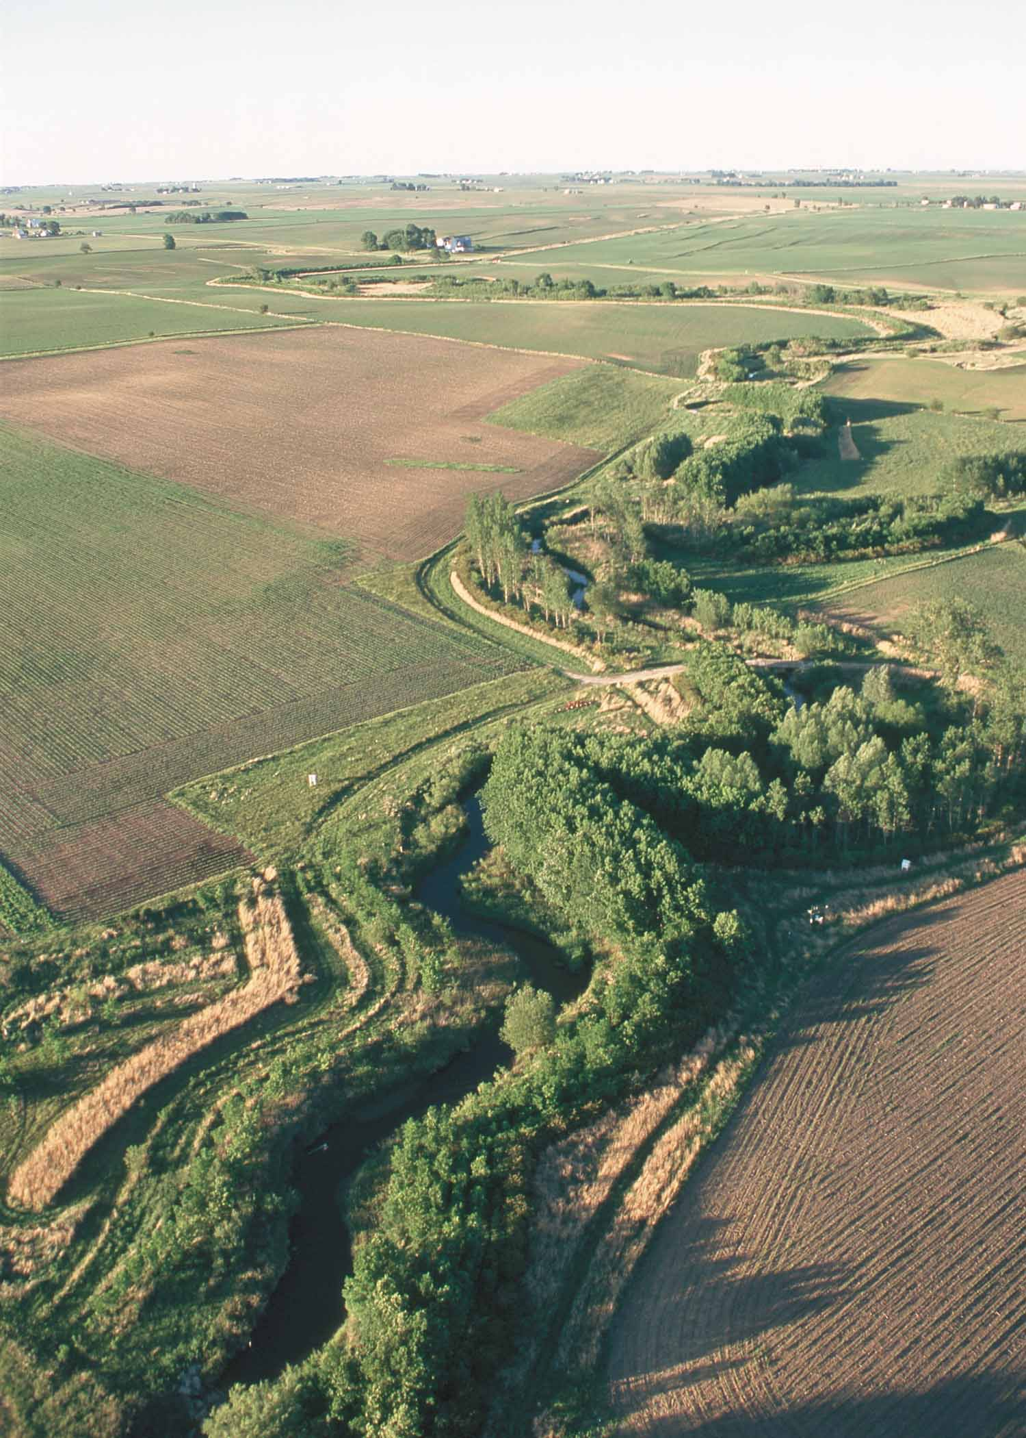
Notes:
US Forest Service NA/State & Private Forestry
Buffer science
How are we doing?

Slide 26
Karl Honkonen
karlwhonkonen@fs.fed.us
US Forest Service
Northeast Area/State & Private Forestry
603-868-7616
www.na.fs.fed.us

