Slide 1
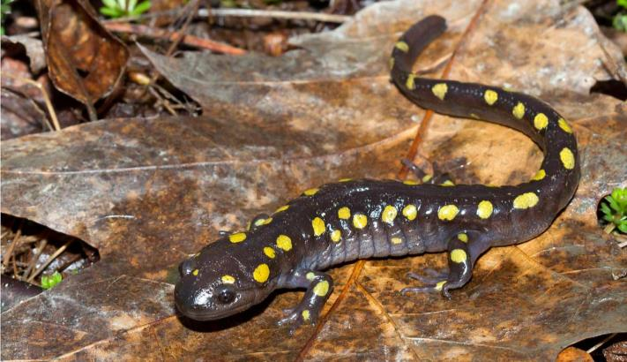
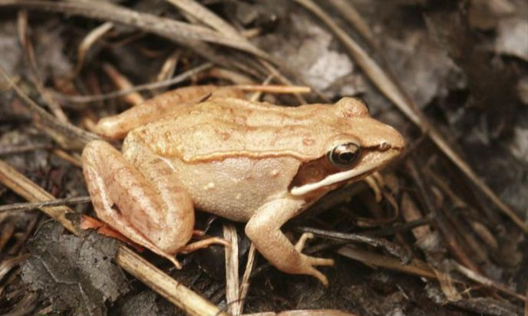
Bioaccumulation of Methylmercury in Wood Frogs and Spotted Salamanders in Vermont Vernal Pools
Steve Faccio – Vermont Center for Ecostudies
Kate Buckman – Biological Sciences, Dartmouth College
Vivien Taylor – Earth Sciences, Dartmouth College
Amanda Curtis – Biological Sciences, Dartmouth College

Slide 2
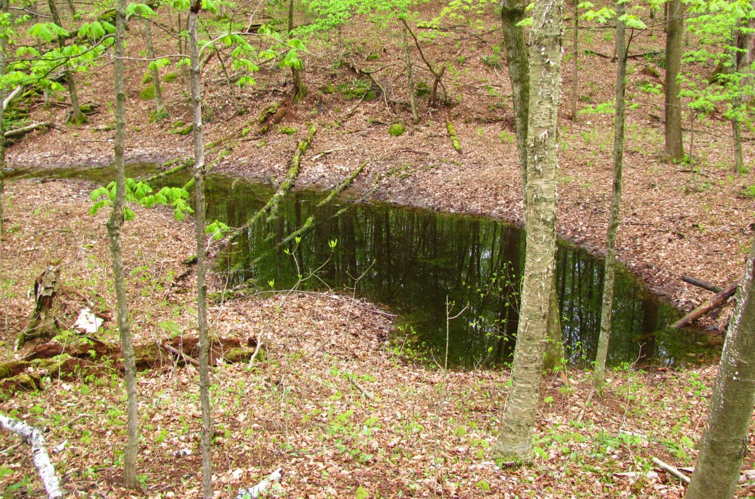
1) Small, shallow, & isolated

Slide 3
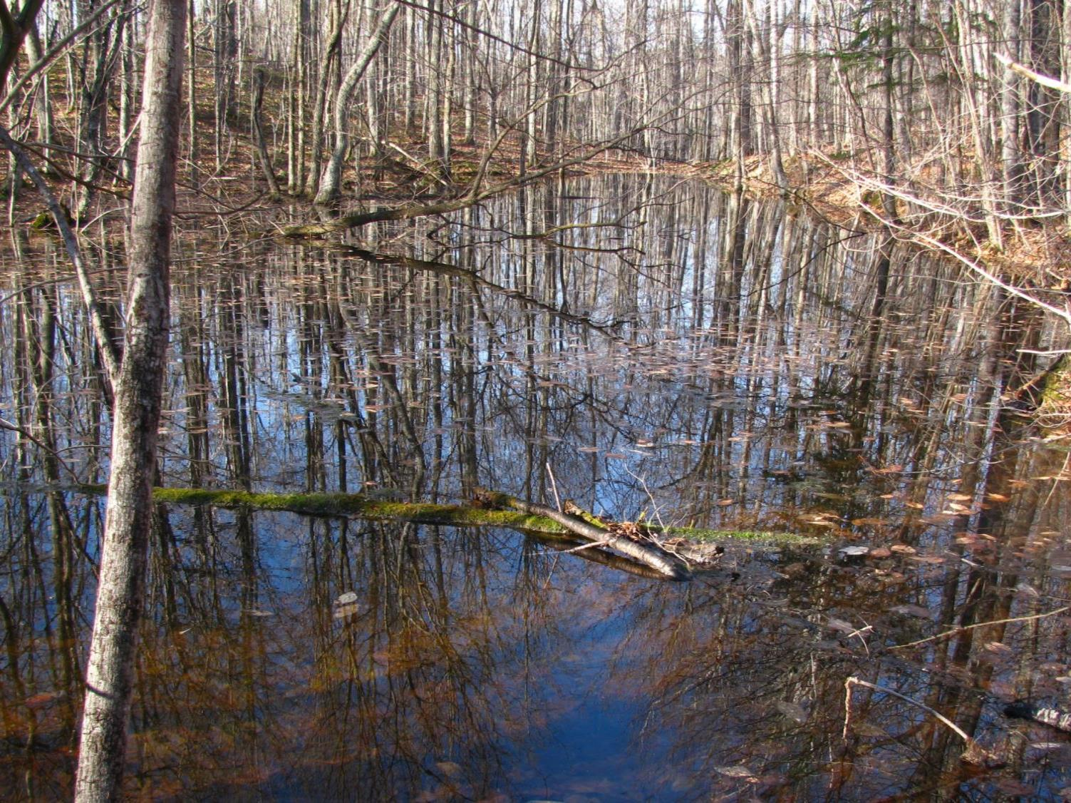
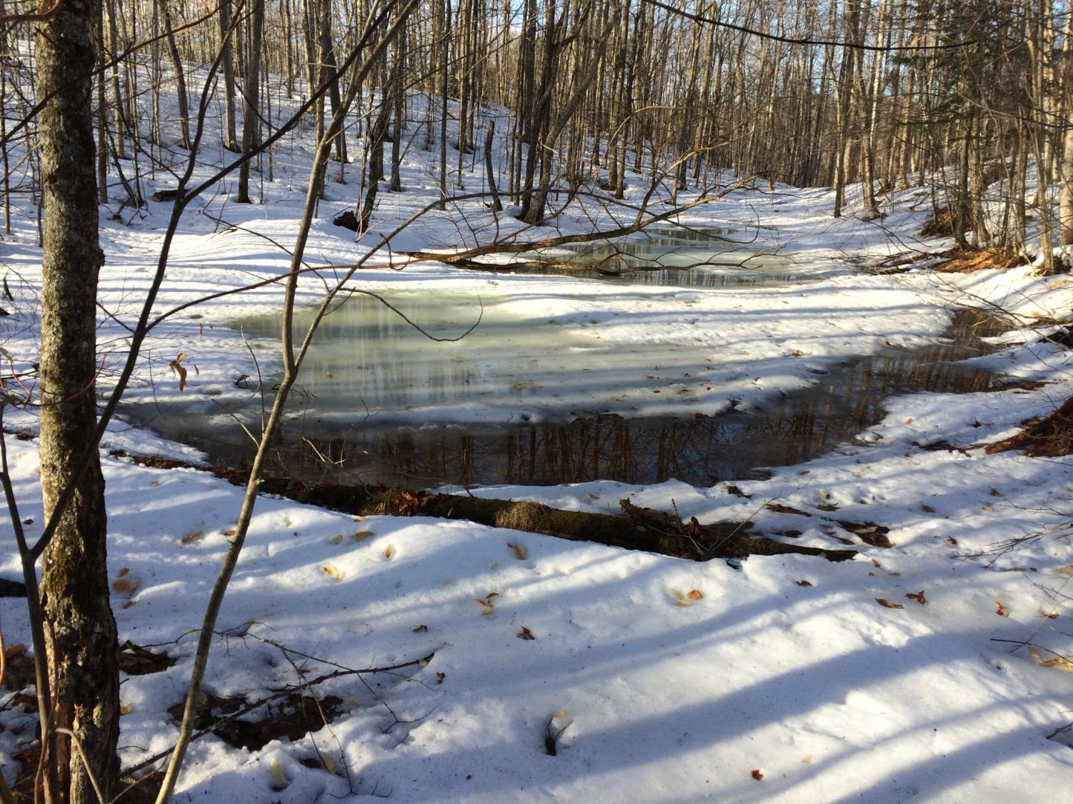
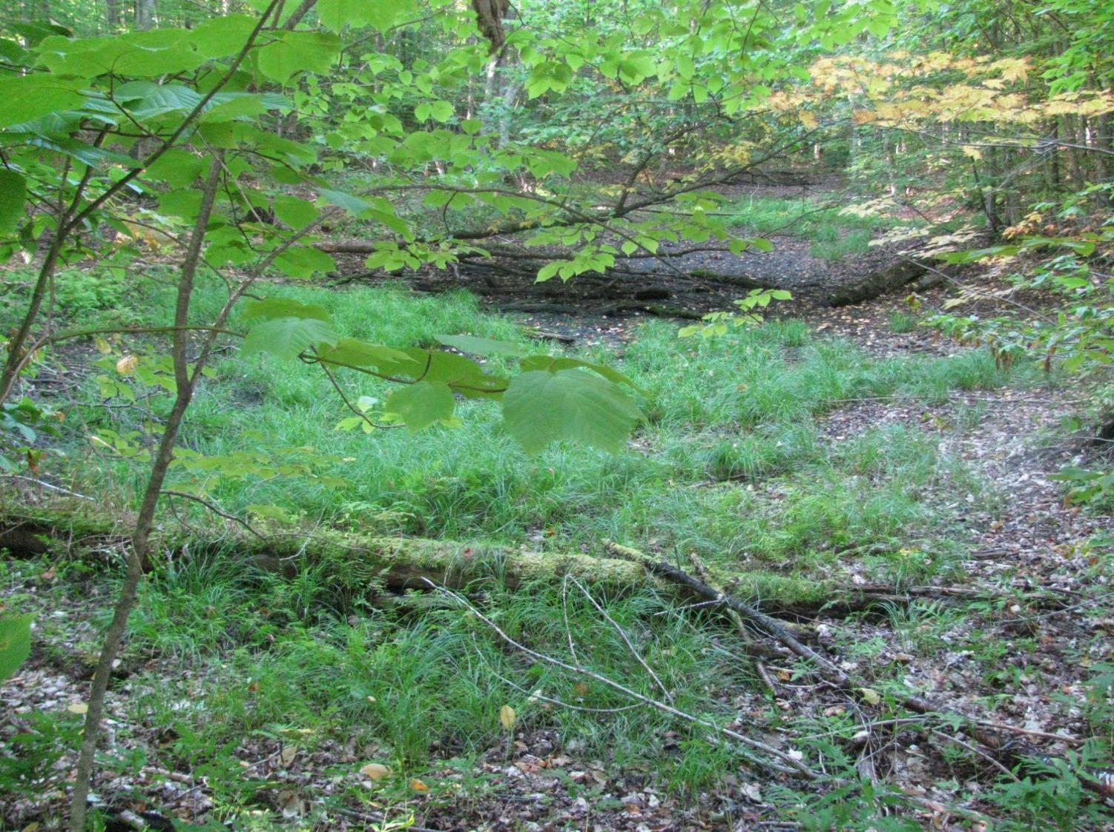
2) Seasonal hydrology (prohibits fish)

Slide 4
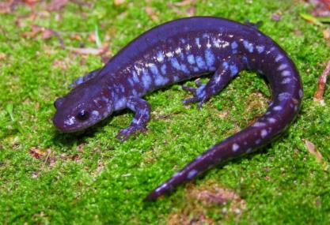
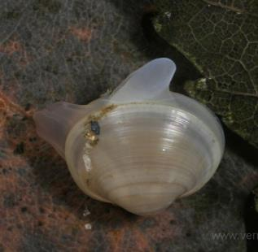
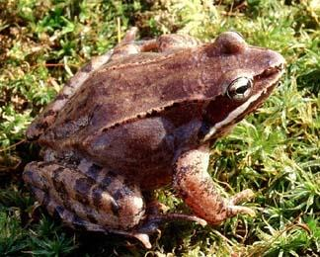
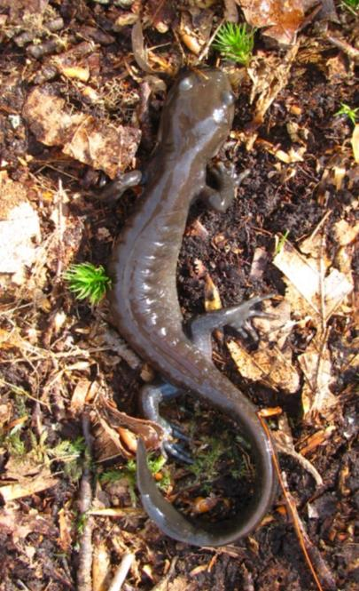
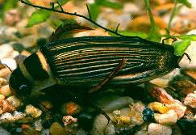
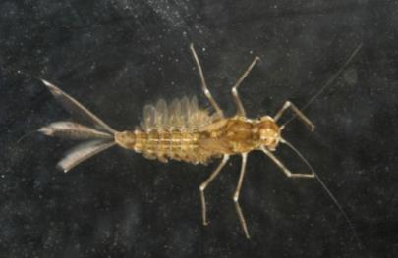
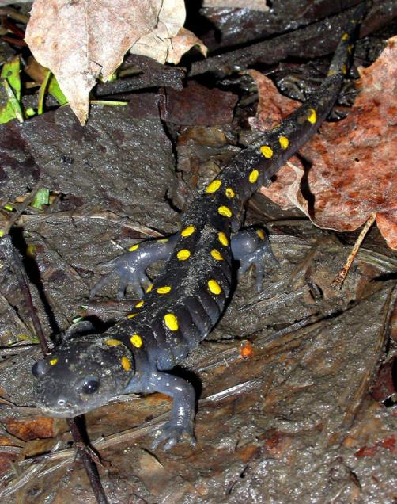
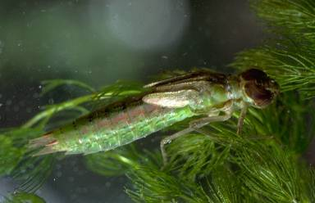
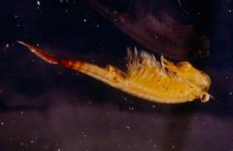
3) Provide critical habitat for invertebrates and amphibians
Notes:
Provide critical breeding habitat for several amphibians as well as supporting a diverse community of invertebrates. Three mole salamanders (JESA, SPSA, and BSSA) are also listed as SGCN in VT’s WAP.

Slide 5
Estimated Total Mercury Deposition
VanArsdale, et al. 2005, Miller et al. 2005.
Notes:
Past studies have shown that the NE is a hotspot for atmospherically deposited Hg, primarily from coal-fired powerplants and incinerators in the MidW.

Slide 6
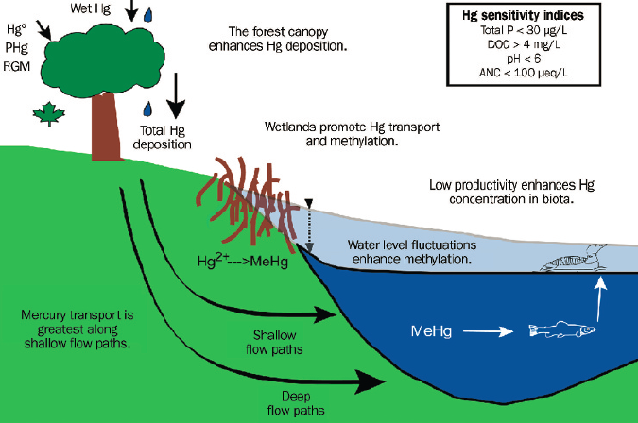
Landscape characteristics enhancing Hg and methylation
0.08
14.6
5.8
From: Evers et al. 2007
Notes:
Several landscape characteristics are associated with enhancing Hg deposition and methylation. 1) forest canopy enhances Hg deposition—leaves scavenge Hg from air, and leached in throughfall and litter fall; 2) Hg transport is greatest along shallow flow paths; 3) water level fluctuations enhance methylation, 4) low primary productivity increases Hg in biota, and 5) wetlands, especially those with low oxygen levels, increase Hg and Methylation.

Slide 7
Project Goal and Objectives
Evaluate the influence of landscape characteristics (forest type and land-use) on production and trophic transfer of MeHg in vernal pools.
Determine Hg levels and water chemistry of VP water samples across a broad spatial scale in VT (n=21 pools)
Monitor temporal trends in THg and MeHg at a subset of pools (n=6) to determine sources and pathways of Hg loading (water, soil, leaf litter, water chemistry)
Analyze THg and MeHg in invertebrates and amphibian eggs, larvae, and adults at a subset of pools (n=6) to assess bioaccumulation and potential transfer to terrestrial foodweb

Slide 8
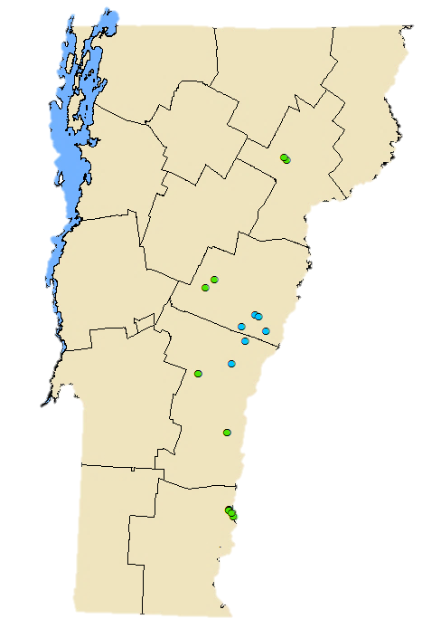
(2)
Intensive (n=6)
(2)
Spatial (n=21)
(2)
(7)

Slide 9
(Elevation)
(305 – 425 m)
(425 – 535 m)

Slide 10
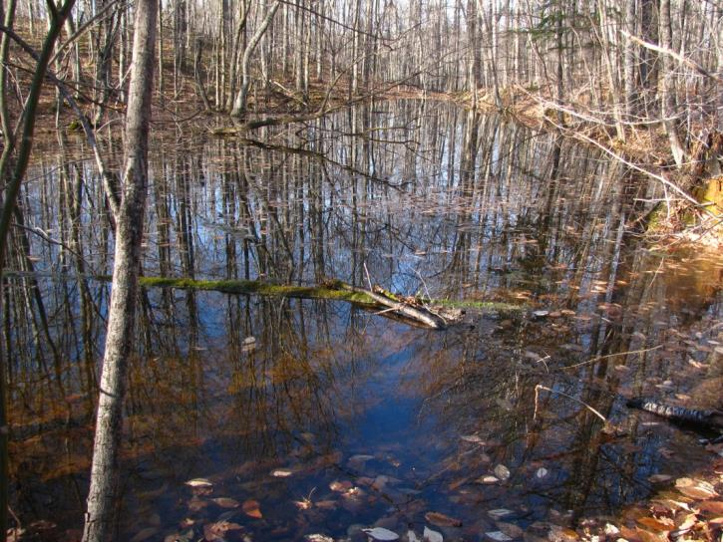
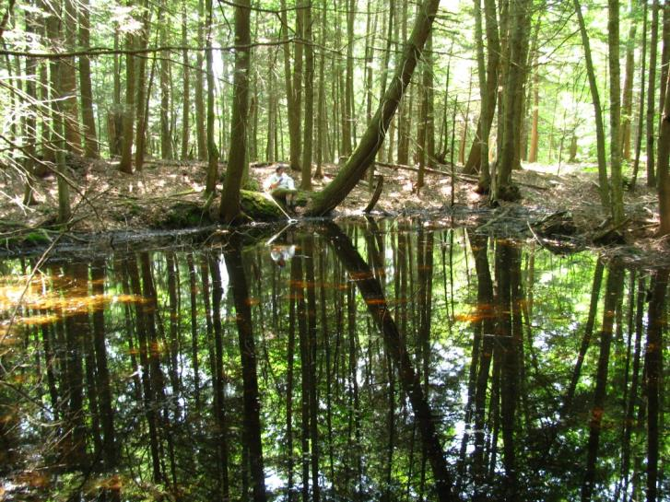
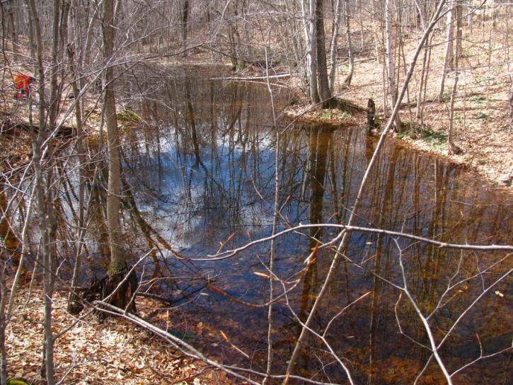
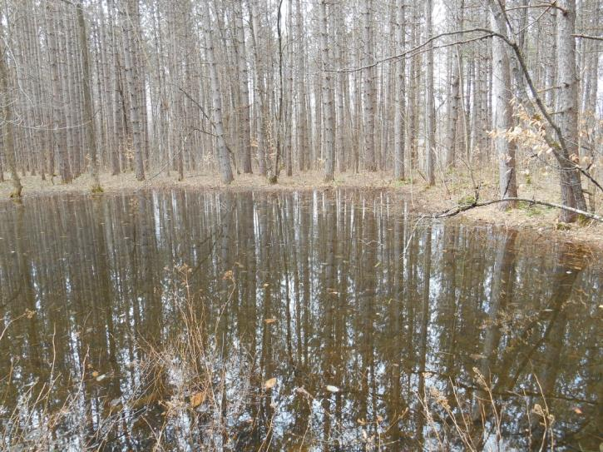

Slide 11
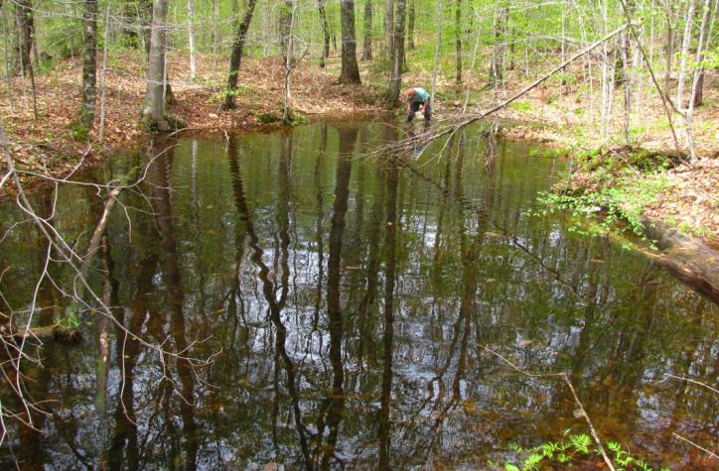
Variable | Mean (range)
 | Coniferous | Deciduous
Perimeter (m) | 54.4 (45.9 - 60.9) | 85.6 (42.7 - 113.7)
Depth (cm) | 43 (18 - 65) | 93 (60 - 120)
Watershed area (ha) | 0.04 (0.02 - 0.09) | 0.63 (0.02 - 1.84)
pH | 5.22 (4.74 - 6.00) | 6.29 (6.05 - 6.39)

Slide 12
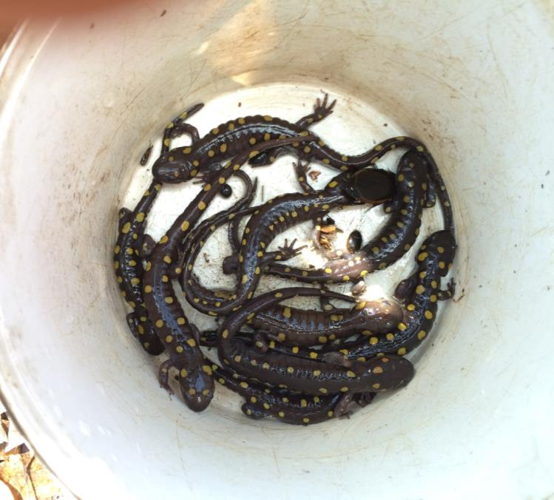
Sampling Methods
Adult
Wood Frog – 4/site (n = 24)
Spotted Salamander – 4/site (n = 24)

Slide 13
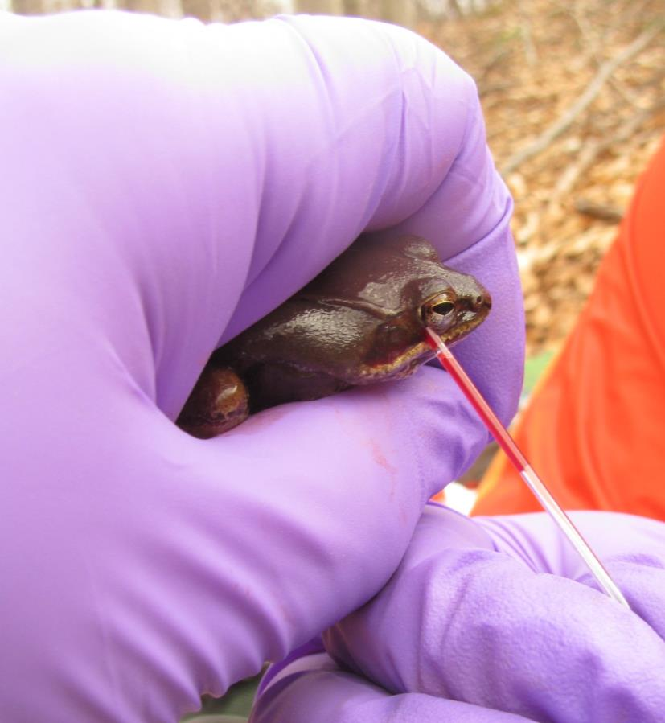
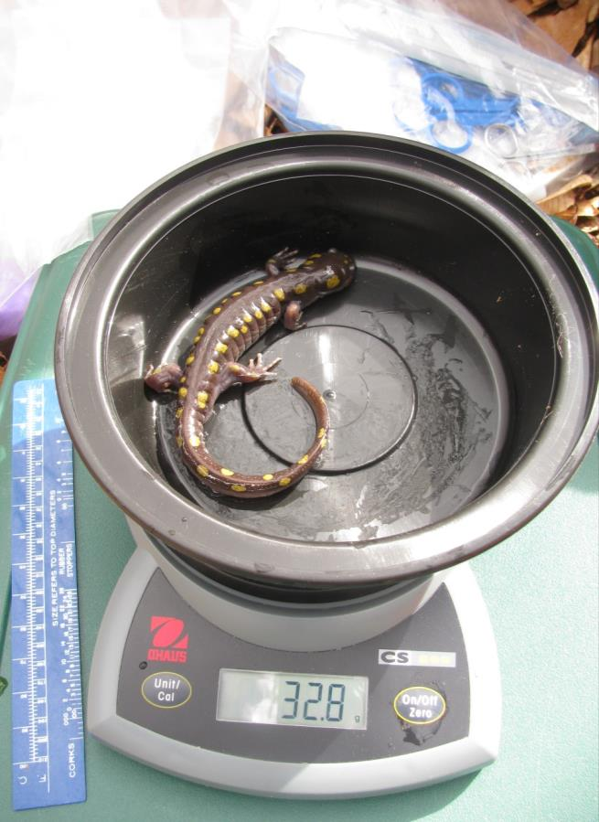
Blood and tissue samples
-- WOFR (toe tip) -- SPSA (tail tip)

Slide 14
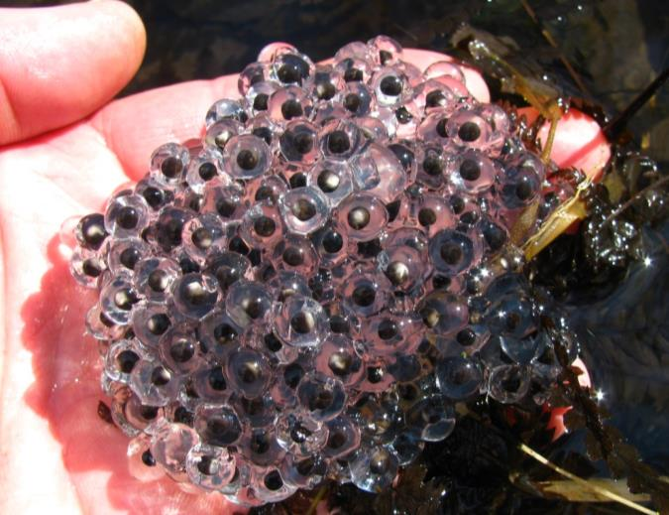
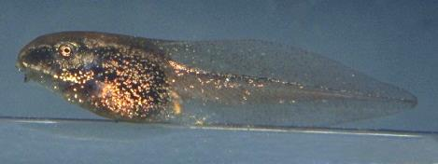
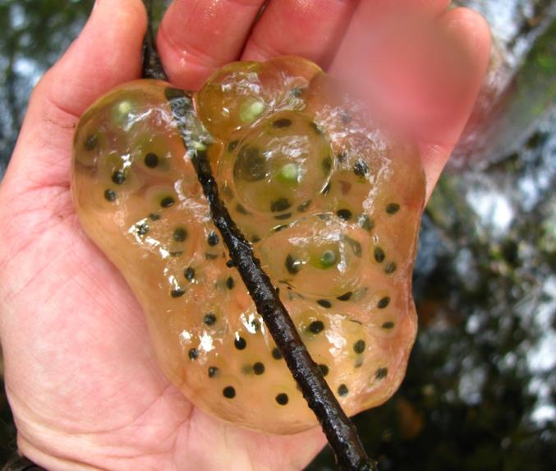
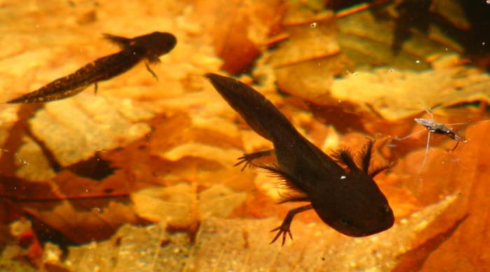
Embryos – 5-10/egg mass, 5 replicates/pool
Total of ~30 samples / spp
Larvae – early stage (n=4/pool/spp)
late stage (n=4/pool/spp)
Total of ~48 samples / spp

Slide 15
Hg Analysis
Species specific isotope dilution using an automated MERX-M interfaced with an Element 2 ICP-Mass Spectrometer at the Trace Element Analysis Lab at Dartmouth College.

Slide 16
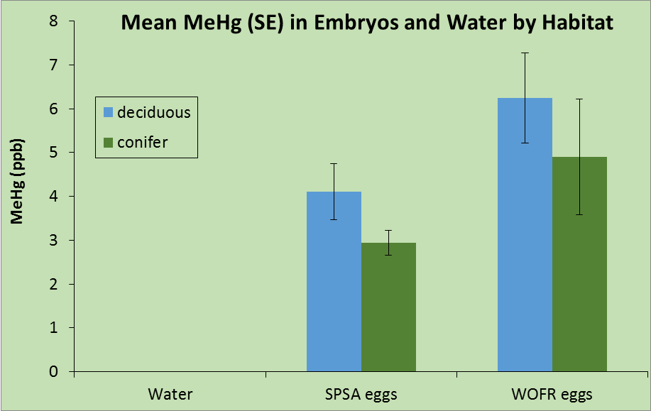
Preliminary Results
0.0011
0.0005

Slide 17
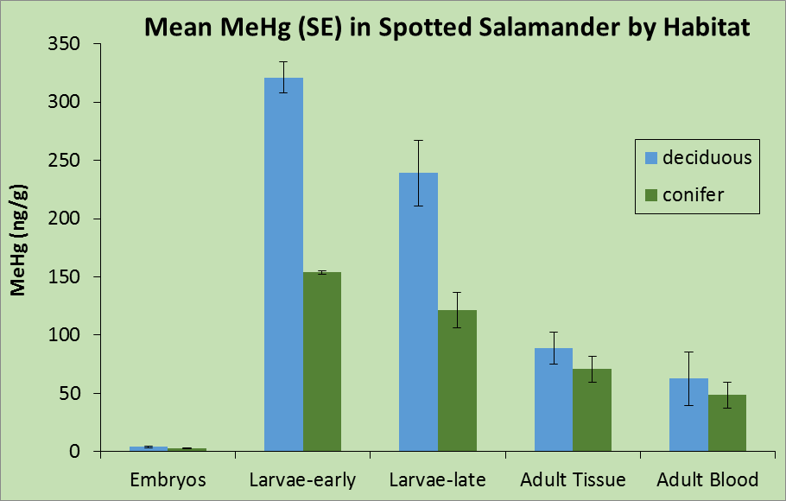

Slide 18
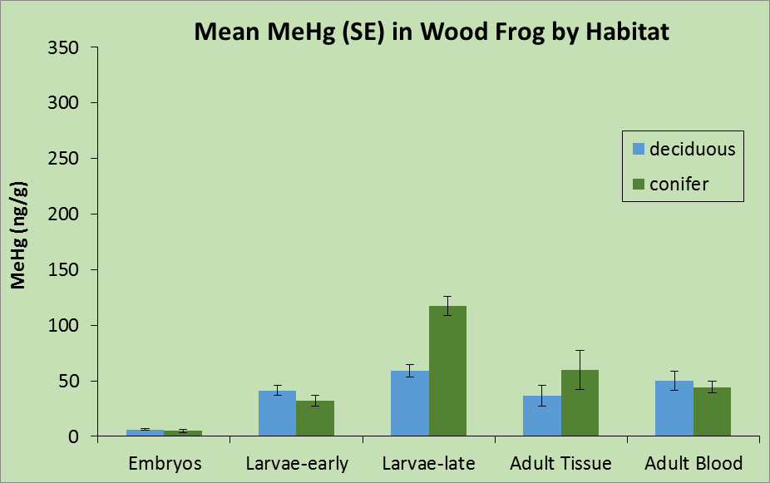

Slide 19
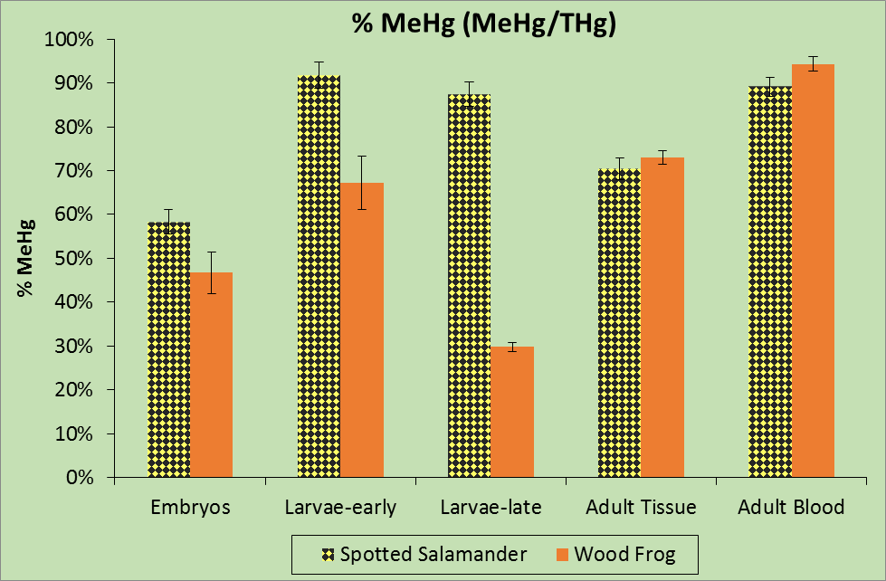

Slide 20
Summary
Eggs
-MeHg levels low, but signif. > H₂O MeHg levels, suggesting adult females depurate Hg burdens during egg-laying.
Larvae
-MeHg in SPSA accumulates rapidly (~50 to 100x egg levels) and is significantly greater in deciduous pools; then declines slightly near metamorphosis
-MeHg in WOFR is moderate (~10 to 20x eggs), but increases with age; is greater in coniferous pools.

Slide 21
Larvae – Elevated MeHg has significant implications for trophic transfer/biomagnification in aquatic food web.
OUR STUDY – WOFR (58 to 117 ng/g)
– SPSA (121 to 321 ng/g)
LAB STUDIES
Wood Frog tadpoles (89 ng/g) → no adverse effects on development, survival, or behavior (Wada et al. 2011)
S. Leopard Frog tadpoles (13 ng/g) → lower survival & decreased metamorphic success (Unrine et al. 2004)
American Toad tadpoles (51 ng/g) → impaired growth (Bergeron et al. 2011)
Suggests interspp. sensitivity to Hg is highly variable
SPSA sensitivity?

Slide 22
Adults
MeHg in SPSA ~2x that of WOFR (SPSA longer-lived)
May represent significant source of MeHg to terrestrial food web.
Future Work?
Metamorphs – does MeHg continue to drop in SPSA until metamorphosis? Afterwards?
– does it continue to increase in WOFR?
Other spp – Jefferson, Blue-spotted, Four-toed?
Difference in Hg burdens of adults by sex?

Slide 23
Acknowledgements
Northeastern States
Research Cooperative
Thanks!
Private landowners
Field Support Lab Support
Meghan Wilson Celia Chen
Rick Biddle
Patrick Mullens
Anne Chalmers

