Slide 1
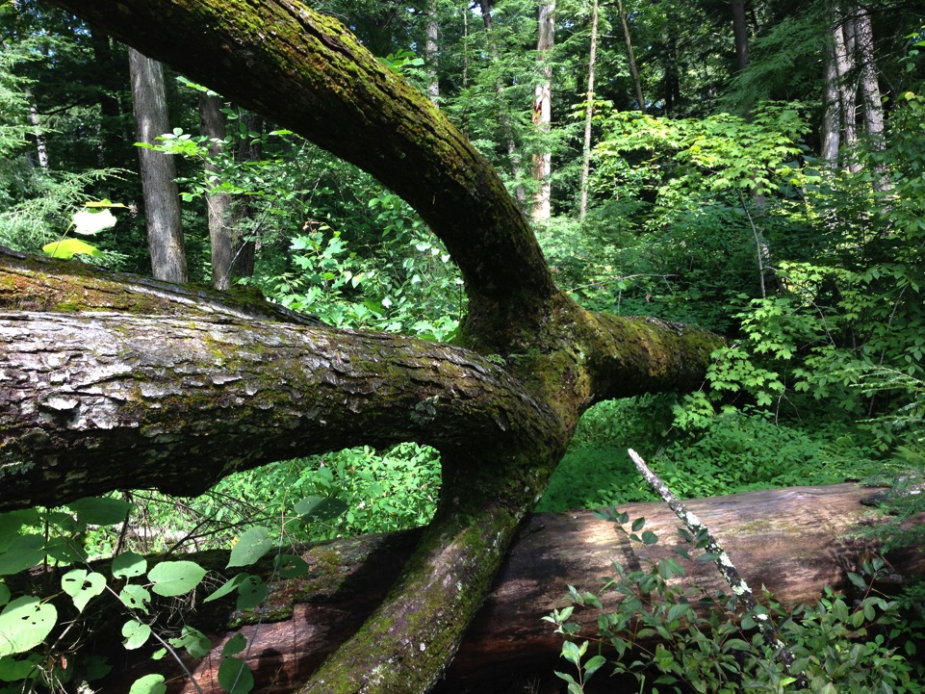


Carbon, mushrooms, and timber – what more could you want? 15 years of the Vermont Forest Ecosystem Management Demonstration Project
Contributors:
Sarah Ford, Jared Nunery, Kimberly Smith, Heather McKenny, Nicholas Dove, Aviva Gottesman, Andrea Urbano, Katherine Manaras-Smith, Thomas Buchholz, Austin Troy
William S. Keeton, Ph.D.
Prof. of Forest Ecology and Forestry
School of Environment and Natural Resources
University of Vermont
Photo credit: Sarah Ford

Slide 2
Sustaining a Broader Array of Forest Biodiversity in Temperate Forest Ecosystems?
Vertebrate habitat associations in the U.S. Northeast
Keeton et al. 2005

Slide 3
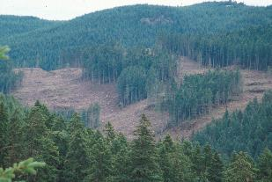
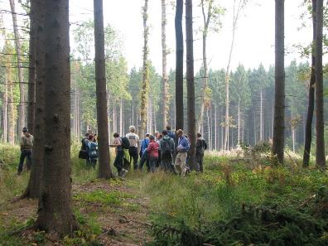
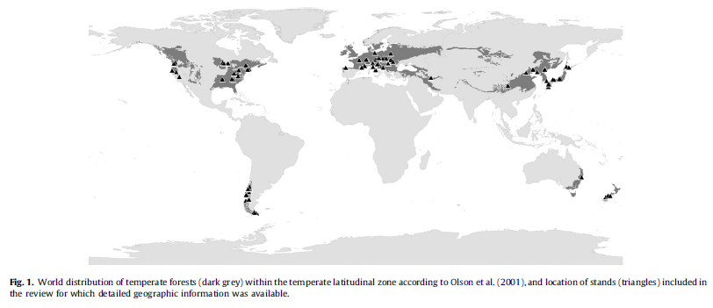
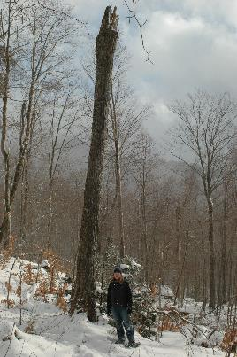
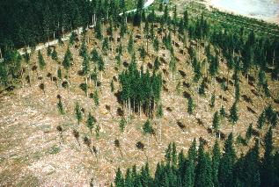
Emulating natural disturbances as an element of sustainable forestry
From: Burrascano, S., W.S. Keeton, F.M. Sabatini, and C. Blasi. 2013. Commonality and variability in the structural attributes of moist temperate old-growth forests: A global review. Forest Ecology and Management 291:458–479.

Slide 4
Forest Age-Class Distributions Since 1600
1.0
19th century
Current
Proportion of Forest Cover
Pre-European Settlement
Data from Cogbill (2000), Lorimer (2001), Lorimer and White (2003)
0
Young
Mature
Old-growth
Stand Age/Structural Condition

Slide 5
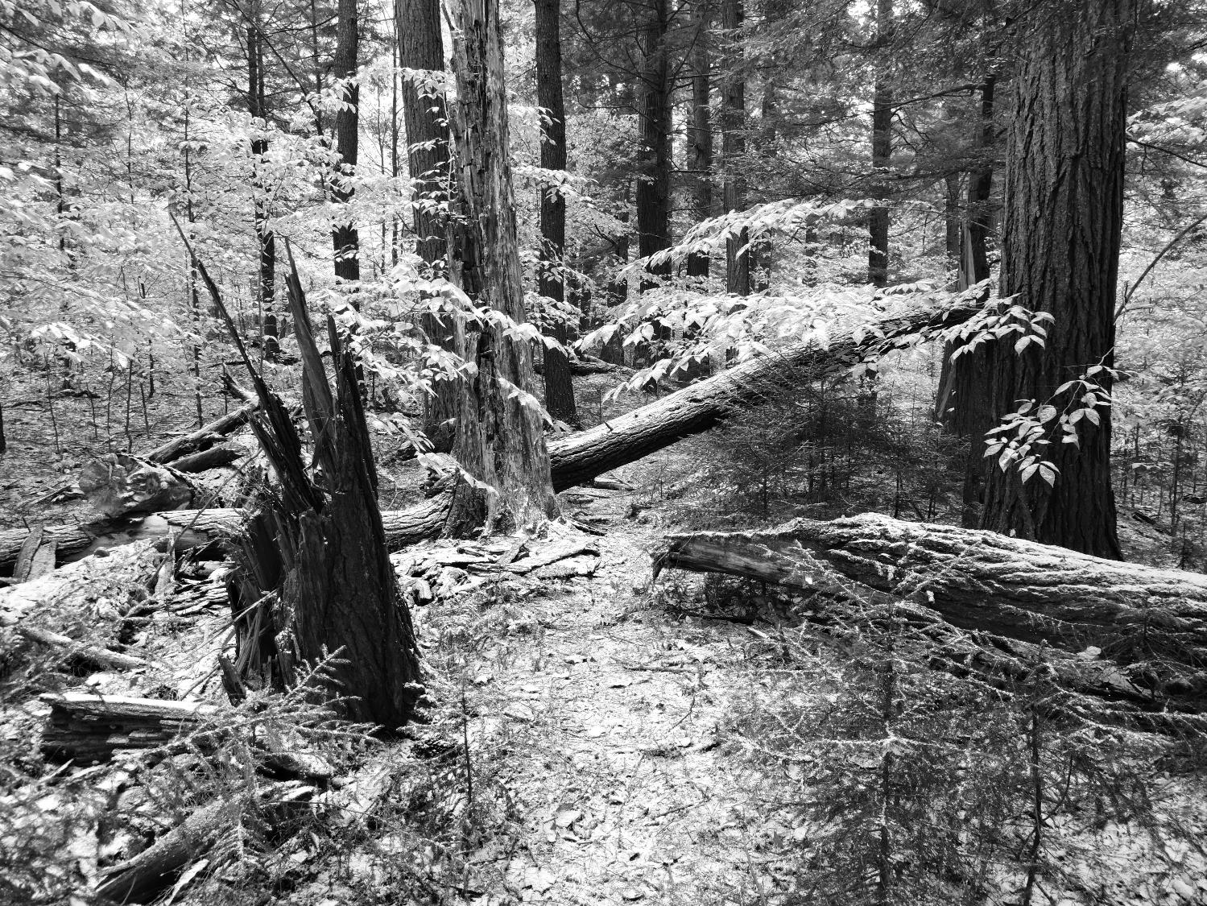
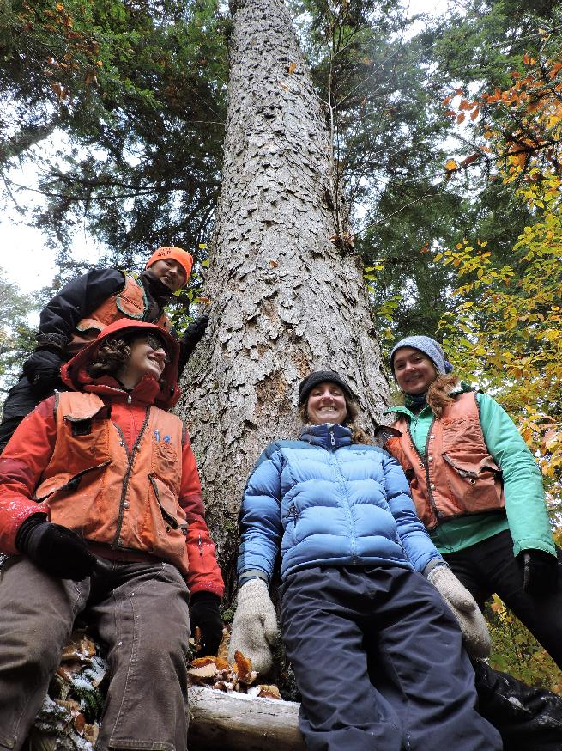

Slide 6
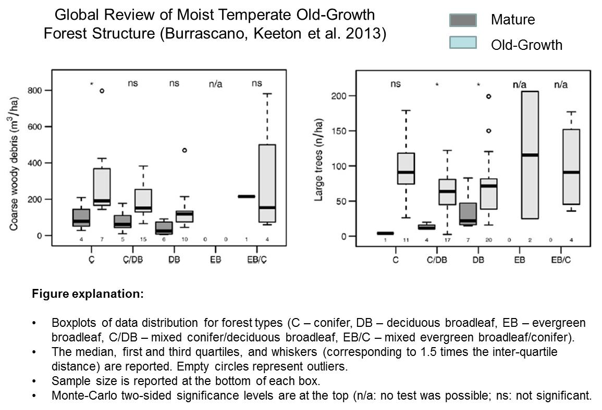
Notes:
It is clear that when we look at mean values, old-growth forests have higher biomass, woody debris volumes, and many other characteristics of significant ecological importance as compared to younger forests. We saw this same contrast in our recent review of published data on temperate old-growth forests globally.
But what of the variability around these means? Is all old-growth of similarly exemplary structure, or does old-growth encompass a range of conditions we should be on the look out for? Our data from Ukraine suggest a wide range of variability, even based on the small set of sites presented here. Variability in structure within and among regions and forest types was also a key finding of the global analysis.
Take for example the ranges of variability for coarse woody debris volumes and large tree densities in this slide. [START ANIMATION] For several general forest types globally the variability around means is much greater than the contrast between age classes.

Slide 7
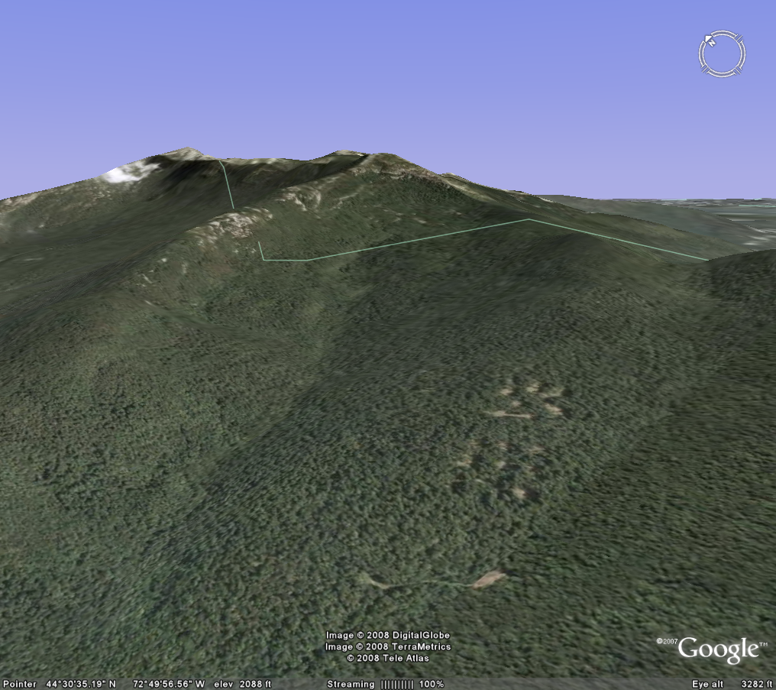
Vermont Forest Ecosystem Management Demonstration Project

Slide 8
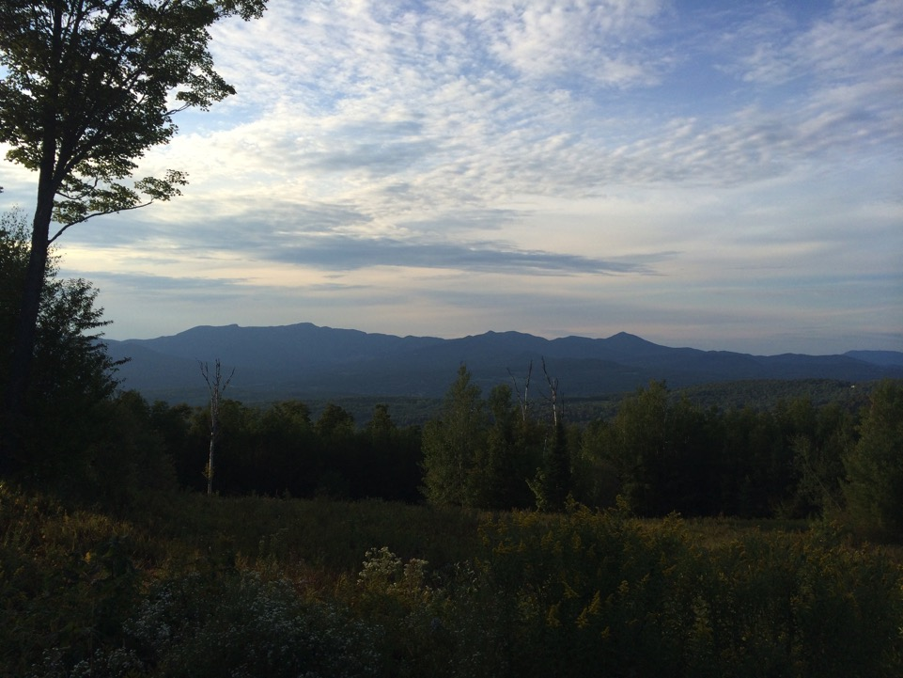
Forest Ecosystem Management
Demonstration Project
Long-term study testing effects of disturbance-based silvicultural treatments on development of late-successional forest structure and function
2001
Study Initiated
(Pre-treatment data)
2003
Treatment Implementation (First year post-treatment data)
2015
Field Inventory
(12-years post- treatment data)
Notes:
Treatments implemented in Northern hardwood-conifer forests in Mt. Mansfield and Jericho VT

Slide 9
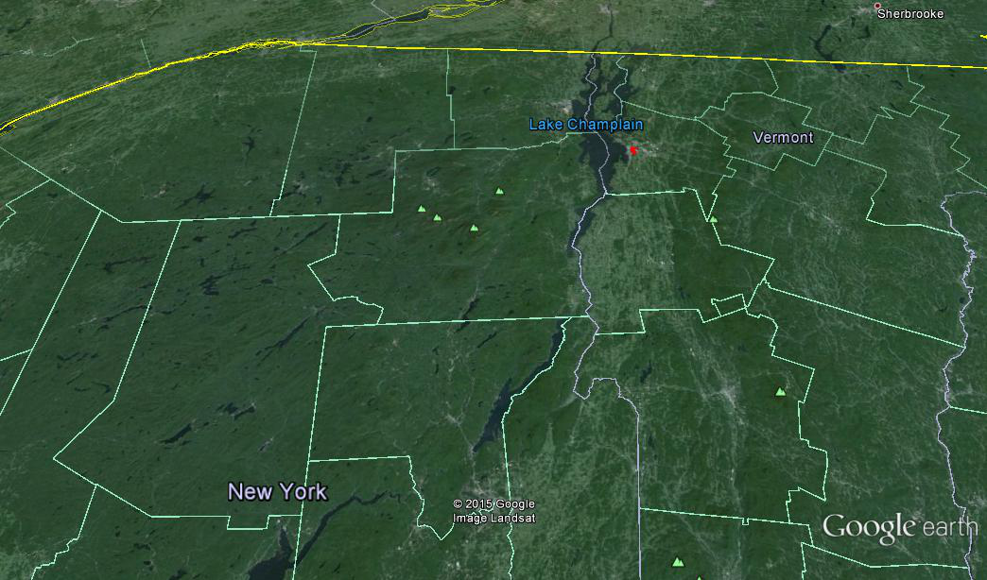
Study Sites
Mt. Mansfield State Forest
Paul Smiths College (FERDA)
UVM Jericho Research Forest

Slide 10
Notes:
Note: The image for SCE does not display the tip-up mounds or small canopy gaps found in this unit. SCE: more heterogeneous vertically and horizontally, more big trees lefts (live and dead), more downed logs and tip ups. Single tree selection: Does a pretty good job of maintaining a multi-layered canopy, but no very big trees, few if any dead trees or downed logs, and homogeneous hortizontal structure (even spacing, few gaps, etc.). These images were generated from the actual plot data at the Mt. Mansfield Study Site. They represent the condition before and immediately after treatment. Remember that for SCE the desired condition is not expected to fully develop for 50 years or so. The treatment is intended to ACCELERATE the rate at which that condition develops. This is very hard to display visually.

Slide 11
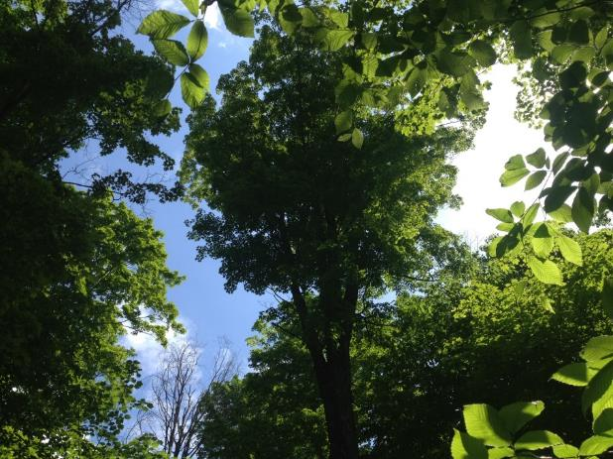

Emulating Natural Disturbances
Structural Complexity Enhancement: Variable density with small gaps (0.02 ha mean)
Modified Group Selection: Irregular sized gaps (0.05 ha mean) with light retention in gaps

Slide 12
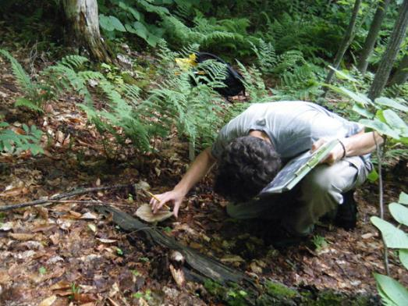
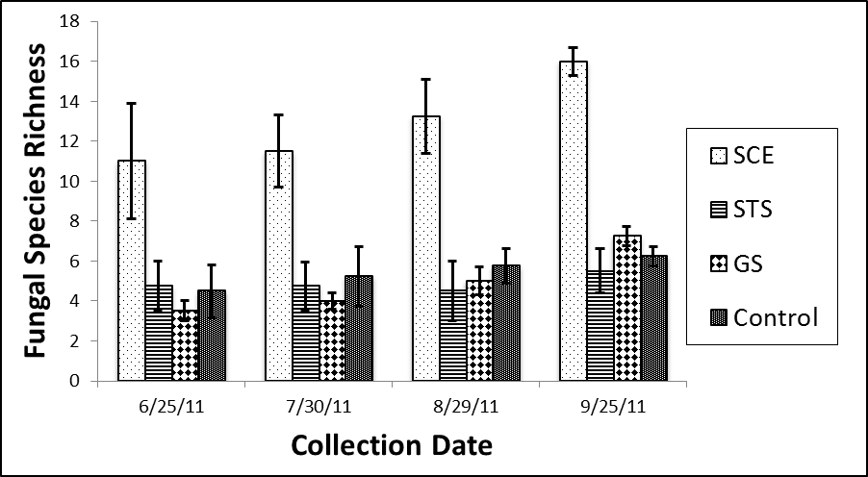
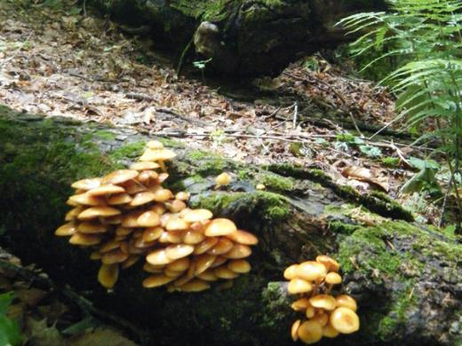
Fungal Responses;
Aboveground Sporocarps
Dove and Keeton. 2015. Fungal Ecology

Slide 13
Fungi Species Richness: Classification and Regression Tree
Initial formula included 7 structural variables
Fungi Richness
Dove and Keeton. 2015. Fungal Ecology

Slide 14
Carbon pool comparisons
Pre- (2001) and post-harvest (2003 and 2013)
“Conventional” is combined single and group-selection
Error bars = +/- one standard error of the mean
Whiskers indicate spread of data.

Slide 15
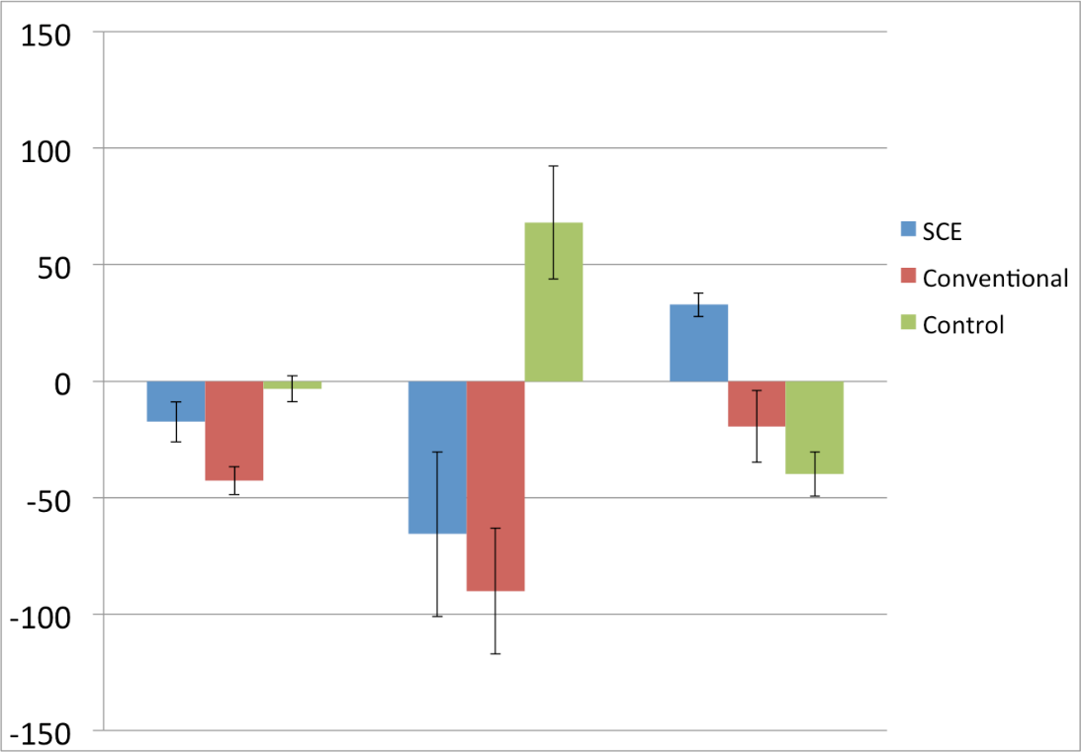
Carbon stocks 10-years post-harvest: Difference compared to simulated “No Harvest” baseline
P = 0.003
P = 0.001
% Difference
Live Tree Standing Dead Downed Log
Notes:
Tukey Kramer HSD (α = 0.05)
Live Tree: Control > Conv. (P = 0.001)
Standing Dead: Control > Conv. (P = 0.009)
Control > SCE (P = 0.023)
Downed Log: SCE > Control (P = 0.003)
SCE > Conv. (P = 0.020)
F definition

Slide 16
Carbon Management Implications
Late-successional/no-harvest biomass (structure)
Structural Complexity Enhancement
15.9%
Measured carbon response after 10 years
Biomass/Carbon
44.9%
CONVENTIONAL
Loss of biomass post-harvest
Time
Adapted from Bauhus et al. 2009

Slide 17
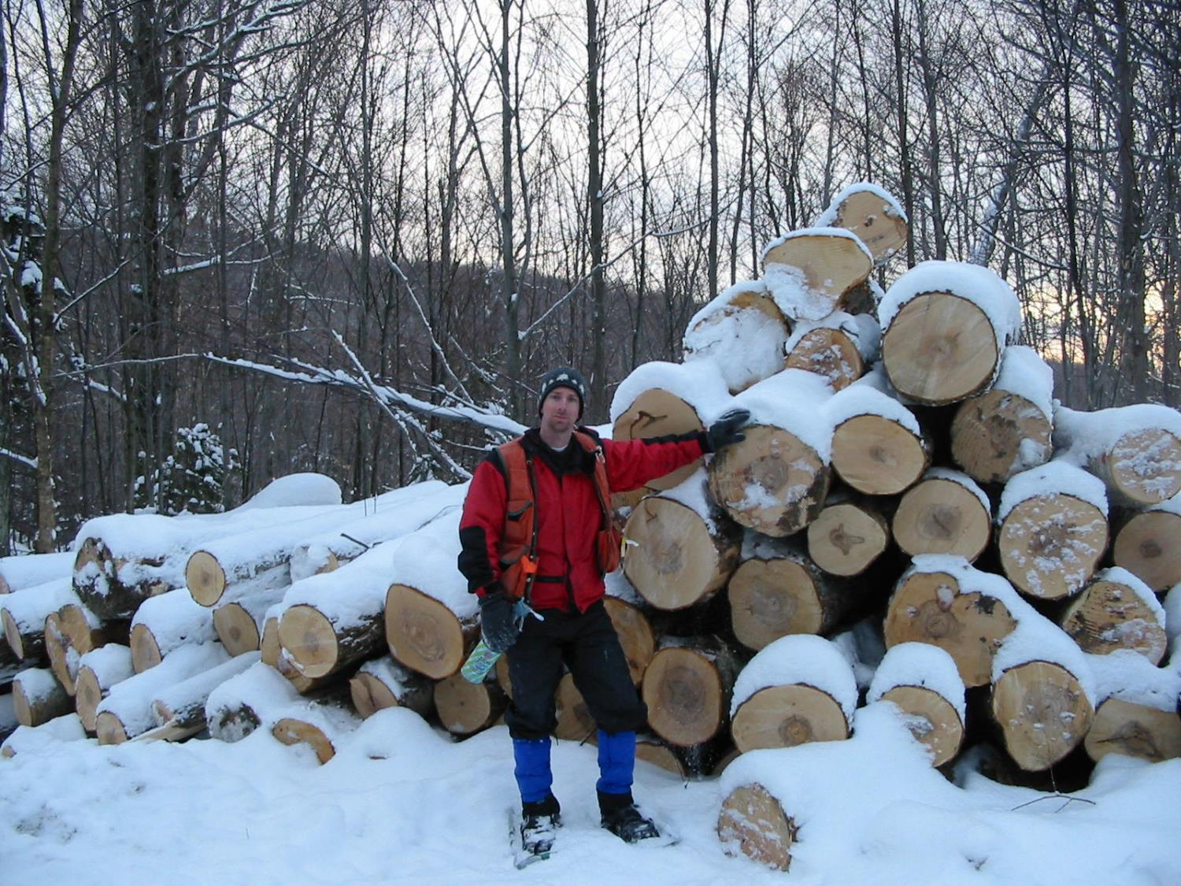
60% of conventional harvest volume
Profit: f(economies of scale, market and site conditions)
Can management for old-growth characteristics generate a profit?

Slide 18
Tree Regeneration Diversity by Treatment, 12 Years Post-Harvest

Slide 19
When, Where, and Why?
CARBON Emphasis
Low High

Slide 20
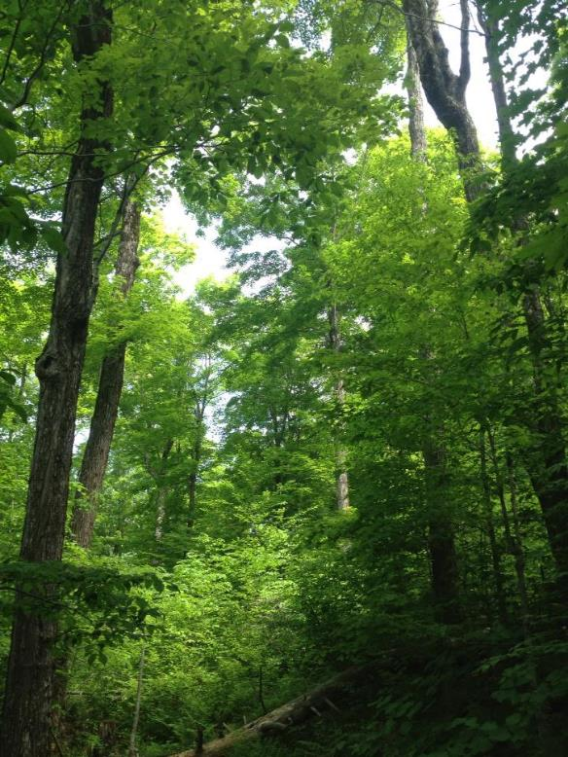
Acknowledgements
Vermont Monitoring Cooperative
U.S. National Science Foundation
Northeastern States Research Cooperative
USDA McIntire-Stennis Forest Research Program
USDA National Research Initiative
Structural Complexity Enhancement unit, Mt. Mansfield State Forest, VT. June 2014

