Slide 1


Soils..
..and the Audacity of the
Vermont Monitoring Coop.
Scott W. Bailey
USFS, Northern Research Station

Slide 2

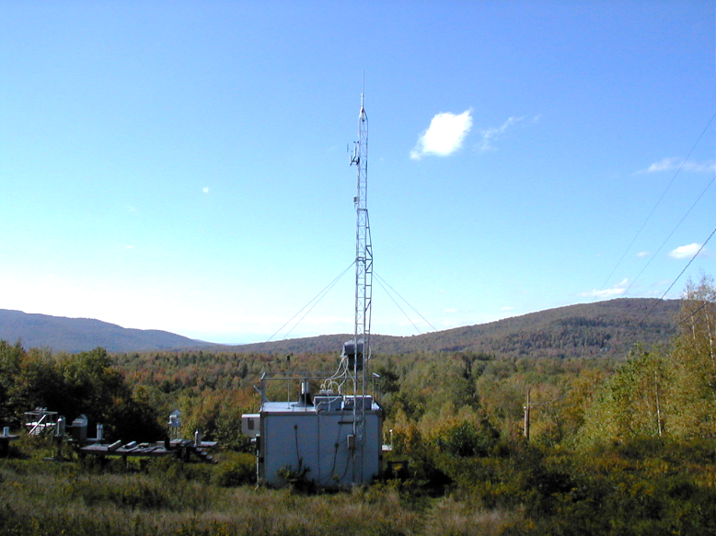
UND002
Underhill, VT
Clean Air Act 1963

Slide 3


Clean Water Act 1972

Slide 4
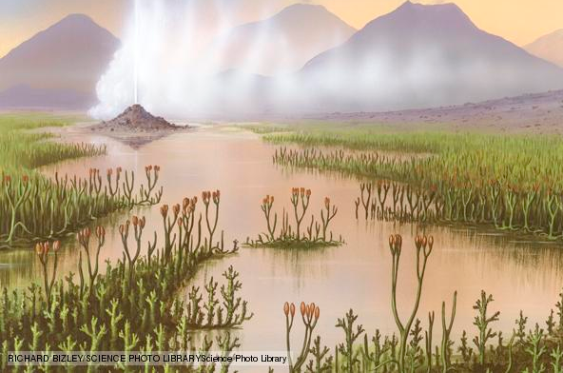
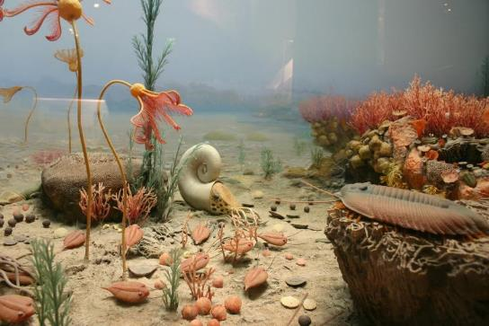
What would Earth be like without Soil?
…Like turning the clock back to the Silurian? (~425 million years ago)
On land: primitive clubmosses, mostly confined to semi-aquatic habitats
Most of life confined to the sea

Slide 5
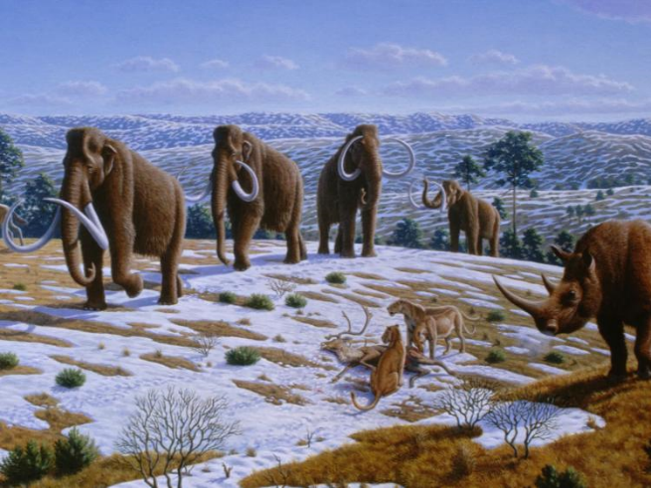
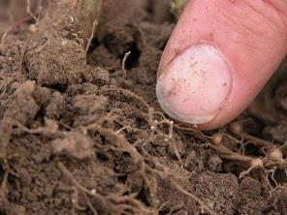
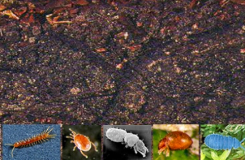
Challenges in Monitoring Soil Quality
Soils have been developing in Vermont for 10,000+ years.
soils change slowly
soils are complex, heterogeneous
soils are alive

Slide 6
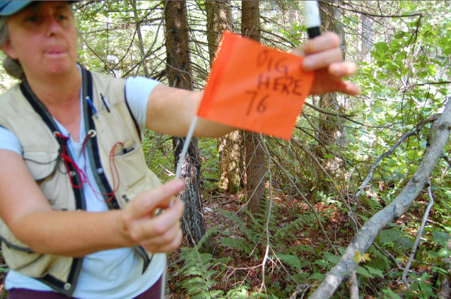
The Vision
recovery from cultural acidification
sustainability of nutrient supplies
fate of pollutant metals (Hg, Pb…)
changing carbon storage as climate warms, forests age…
Sandy Wilmot
Launched: Proctor Maple Research Center, April 29, 1998

Slide 7
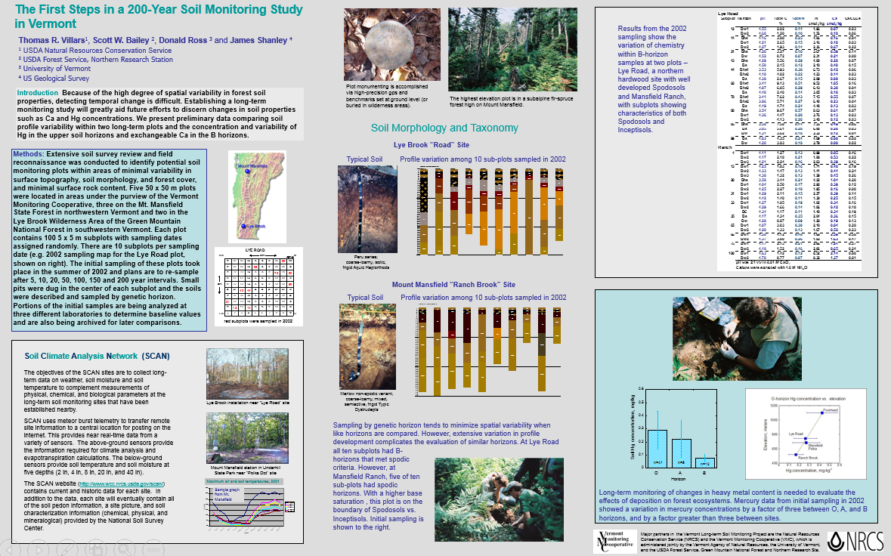
Thom Villars et al. 2005 Soil Science Society of America Annual Meeting, Salt Lake City

Slide 8
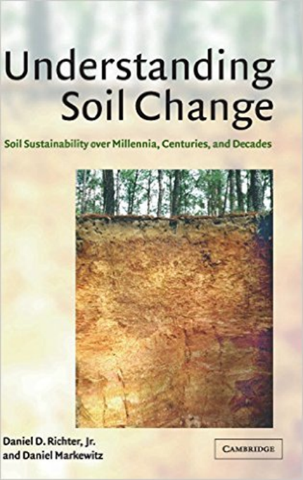
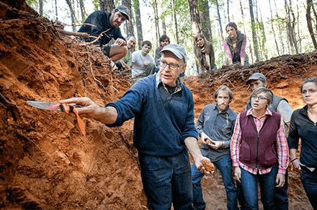
Wow, the audacity of it!

Slide 9
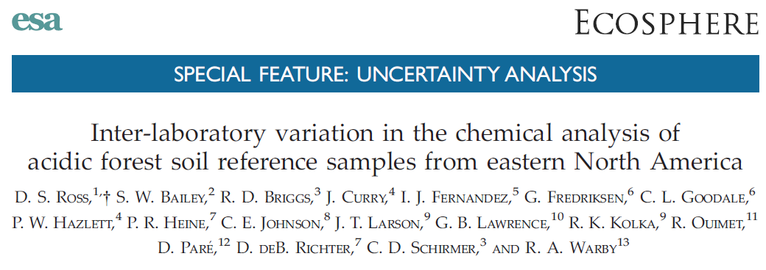

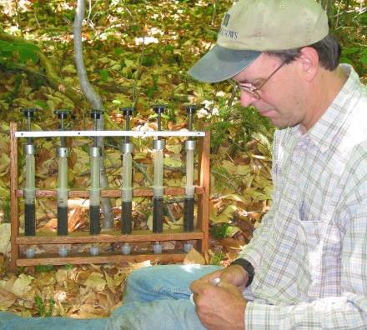
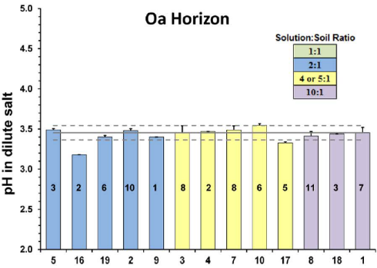
Don Ross

Slide 10
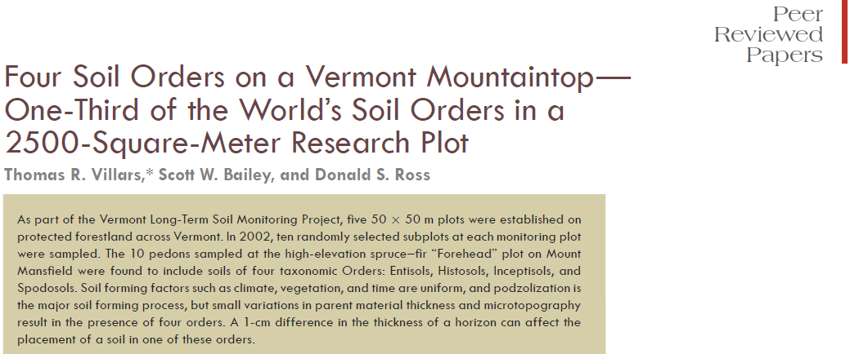

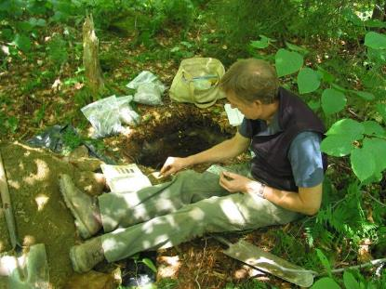
Thom Villars

Slide 11
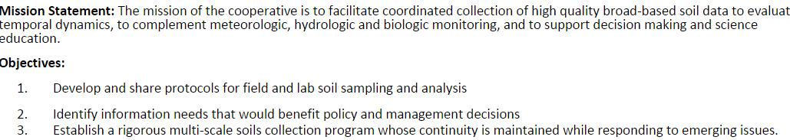
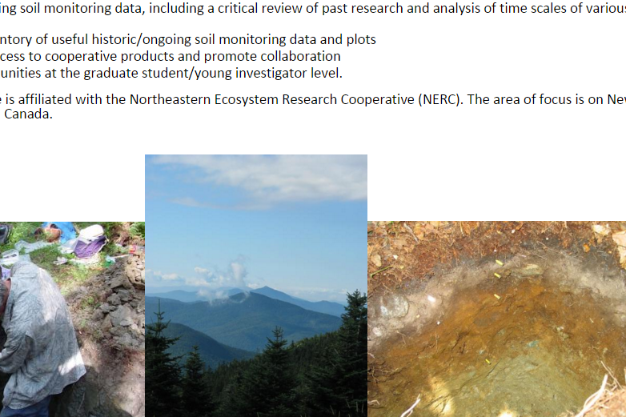
http://www.uvm.edu/~nesmc/

Slide 12
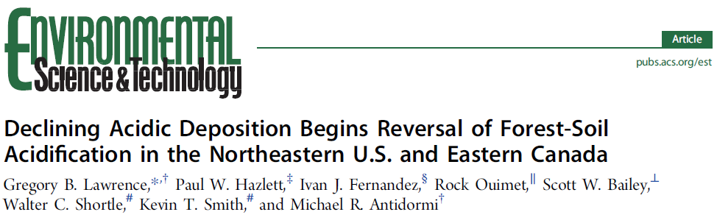
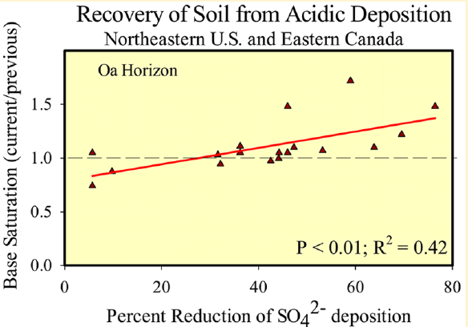

Slide 13





Happy 25th Anniversary VMC!
Long-term Soil Monitoring Project 2002 – 2015 →2202
Save the Date: 2017 next sampling
Sandy Wilmot* (VT-ANR), Carl Waite (VMC), Jim Duncan (VMC), Thom Villars* (NRCS),
Nancy Burt* (GMNF), Angie Quintana-Jones (GMNF), Don Ross* (UVM), Deane Wang* (UVM), Jamie Shanley (USGS), Scott Bailey* (FS-NRS)
*founding participants ………and into the future…………..???

